Slide 1
[Place your logo here]
UK Primary Schools
Financial Literacy
[Insert your firm name]
Chartered Institute for Securities & Investment

Slide 2
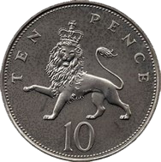
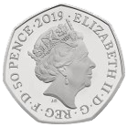
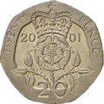
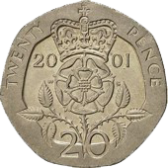
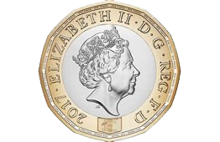
Do you recognise these?
Notes:
HOLD UP CASH – see which coins they recognise
Ask them about the people on the coins, significance and why change
Understand that if you add money together it can produce another coin so these three coins total

Slide 3
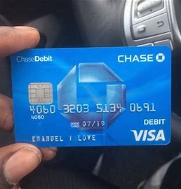
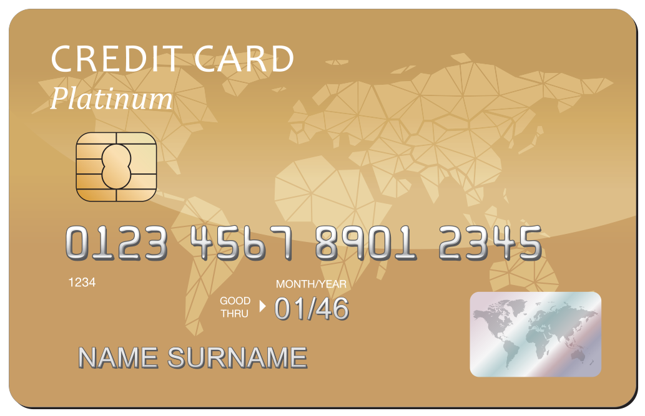
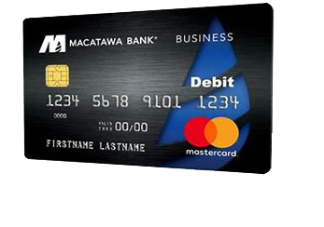
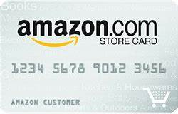
Spot the difference
Notes:
Ask the class difference between each card
Ask the word Debit – who knows what that means
What is credit? – explain credit someone “owes” a company money , explain difference to a loan
What is a store card?
What is the difference between a store card and a gift card
Different cards are used in different ways depending on the type

Slide 4
Credit cards
Money you are borrowing from a bank
You have to pay the bank back the amount, and a bit extra
You usually pay the bank back monthly
Notes:
Credit card

Slide 5
Debit cards
Money you own, kept in your bank account
When using this card you are spending your money
Notes:
Debit card

Slide 6
Store cards
Store cards are a type of loan, where you borrow money from the store
You use this to buy items at the store of the card
You pay the full amount back to store, and a bit extra

Slide 7
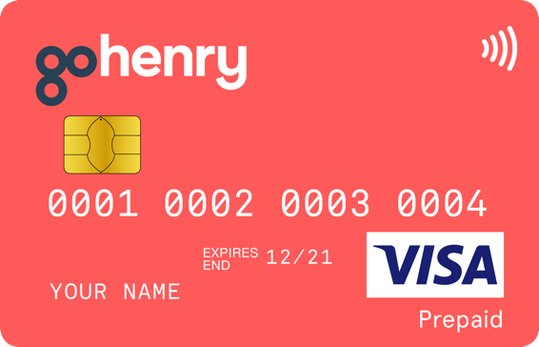
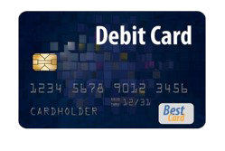
When can I use a bank card to pay for things?
Prepaid cards where parents can load money onto a card – age 6+ (monthly fees do apply to have an account)
Debit cards linked to a child's bank account – age 11+ (offered by high street banks and do not charge a monthly fee)
Notes:
Why use either of these bank cards?
Not borrowing money from bank
Can only spend what you have in your bank account
Easy to monitor what you spend
Helps you learn about money & banking

Slide 8
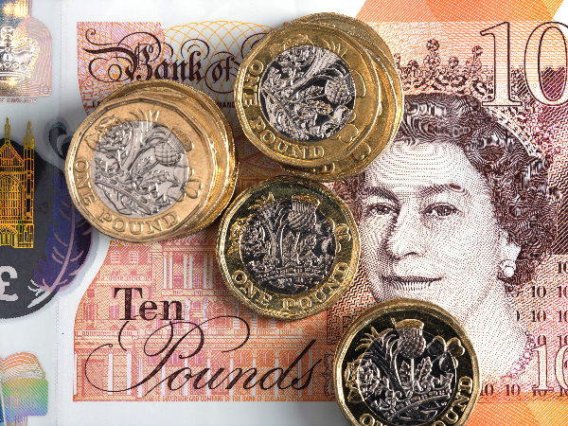
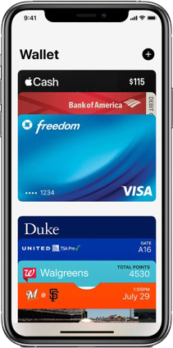
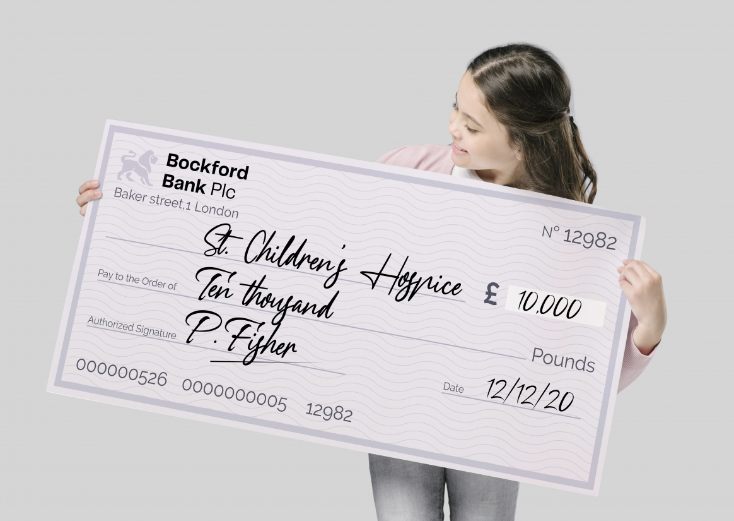
Ways to pay for things
Technology has contributed to cash not being used as much
Money is used to pay for goods and services
Cheques – not used as much but is a method of payment

Slide 9
Why work?
“Because I need money”
“Because I love my job”
“Because my parents want me to”
“So I can buy clothes or games”
“So that I can go on holiday”
Notes:
People work to earn money

Slide 10
Notes:
How do I save
How can I earn money
Why should you save

Slide 11
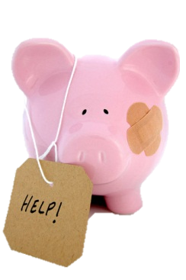
Budget! Save little & often…
50p a day

Slide 12
Budget! Save little & often…
50p a day = £3.50 a week

Slide 13
Budget! Save little & often…
50p a day = £3.50 a week
£3.50 a week = £15 a month

Slide 14
Budget! Save little & often…
50p a day = £3.50 a week
£3.50 a week = £15 a month
£15 a month = £180 a year

Slide 15
[Place your logo here]
Please ask your questions

