Slide 1
Working Relationships Between Financial Planners and Paraplanners – Overcoming Differences of Opinion
Michelle Meredith & Martin Ruskin
Paradigm Norton Financial Planning

Slide 2
Hello!

Slide 3
Paradigm Norton
Paradigm Norton is a multi award winning financial planning firm
Based in Bristol, London and Torquay
Team Based Approach

Slide 4
Our collective wisdom – the good…
Communicate, communicate, communicate
Be an active listener
Leave your ego at the door
Recognise your value and expertise
You must be able to challenge
Embrace the team approach
Take responsibility as it is offered
Respect personality differences

Slide 5
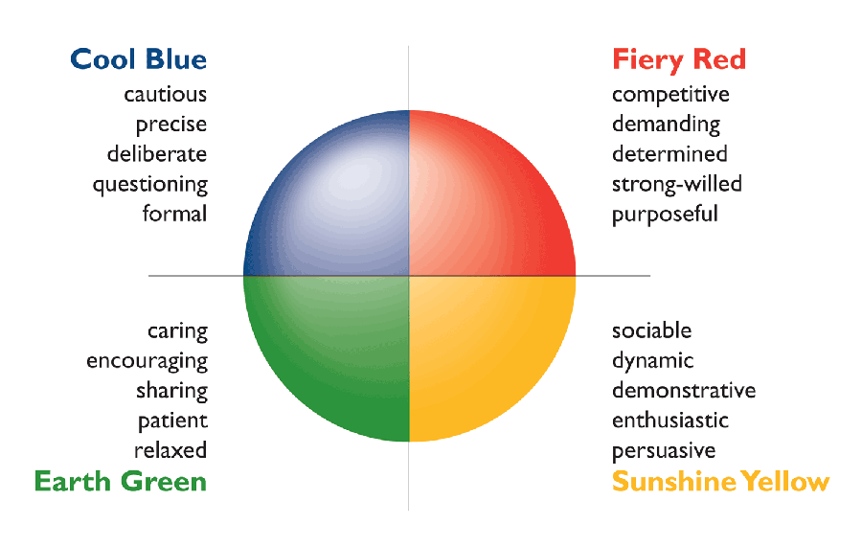
How is your Emotional Intelligence?
Source: http://scottschwefel.com

Slide 6
“Trust is the glue of life. It's the most essential ingredient in effective communication. It's the foundational principle that holds all relationships”.
Stephen Covey

Slide 7
The Bad…
Blurred lines
No space to create
The curse of the factfind
Lack of chemistry
Respect cuts both ways
Mis-matched

Slide 8
And the ugly?

Slide 9
The content of this presentation is intended to be generic and does not constitute any form of specific advice, recommendation or arrangement by Paradigm Norton Financial Planning Ltd. Paradigm Norton Financial Planning is authorised and regulated by the Financial Conduct Authority.
RMT 207/06.18/LH

