Slide 1
How are your clients behaving?
For financial intermediary use only. Not approved for use with customers.

Slide 2
Learning objectives
By attending this session, delegates will be able to:
Identify key common behavioural biases
Discuss the regulatory concerns
Recognise where biases may be presented in the advice process
Explore ways in which good practice can positively use the impact of behavioural bias

Slide 3
Freedom and Choice
These reforms create more choices for individuals, and we want people to be equipped and ready to make informed decisions.
Treasury: July 2014
Notes:
http://workspaces/dms/sources/jrsjrl/_layouts/15/DocIdRedir.aspx?ID=SRCID-11-4834
Treasury July 2014 – Freedom and Choice in Pensions -Government response to the consultation - Page 3

Slide 4
Mind the gap!
AJ Bell senior analyst Tom Selby adds:
“The reforms are essentially a massive experiment of human behaviour…..”
Money Marketing 20/9/2017
Notes:
https://www.moneymarketing.co.uk/mps-launch-inquiry-pension-freedoms/?cmpid=pmalert_3987690&utm_medium=email&utm_source=newsletter&utm_campaign=mm_daily_news&adg=E833E7BB-578C-43A9-820F-AFE84C9858F1
http://workspaces/dms/sources/jrsjrl/_layouts/15/DocIdRedir.aspx?ID=SRCID-11-6512

Slide 5
Vulnerability and behavioural bias
behaviours
vulnerability
We also expect them to exercise extra care where consumers may be vulnerable.
Best practice should take on board positive uses of behavioural research to help customers towards better outcomes.
FCA 2017
FCA: Our Future Approach to Consumers 2017
For financial intermediary use only, not to be used with customers.
Notes:
Page 8 http://workspaces/dms/sources/jrsjrl/_layouts/15/DocIdRedir.aspx?ID=SRCID-11-6816

Slide 6
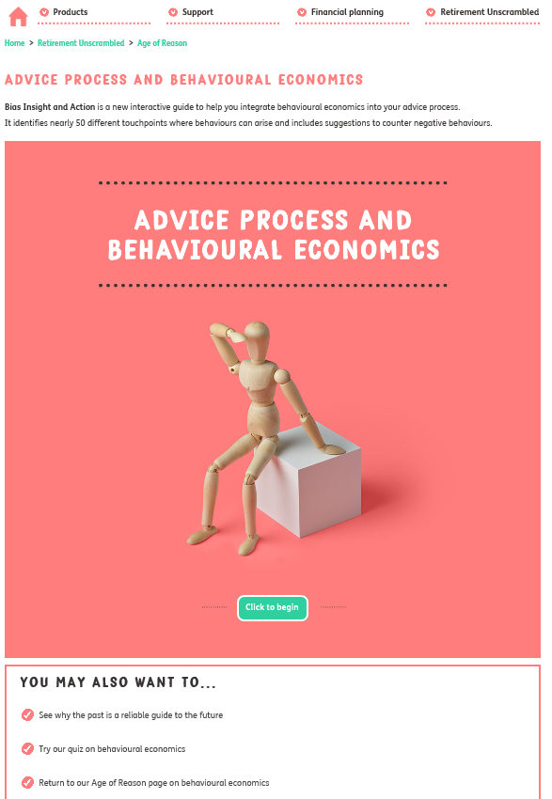
Here to help – behavioural bias tool

Slide 7
Potential bias in the advice process
Initial meeting
Agree objectives
Present options
Recommend IMPLEMENT
About client
Financial AUDIT
Risk profile
INCOME NEEDS
Death benefits
INCOME EXPENSES
Income expenses
About us
<
>
recommend
implement
HERDING
REGRET AVERSION
Mental accounting
Mental accounting
Hyperbolic discounting
Hyperbolic discounting
Mental accounting
Paradox of choice
Hyperbolic discounting
Status quo bias
HERDING
Framing
REGRET AVERSION
Optimism bias
Default bias
Paradox of choice
RECIPROCITY
AVAILABILITY BIAS
LOSS AVERSION
Optimism bias
Framing
LOSS AVERSION
RECIPROCITY
Projection bias
Familiarisation bias
Familiarisation bias
Optimism bias
Hyperbolic discounting
Framing
Familiarisation bias
Optimism bias
overconfidence
Framing
AVAILABILITY BIAS
REGRET AVERSION
Hyperbolic discounting
Framing
AVAILABILITY BIAS
Hyperbolic discounting
Disposition effect
Projection bias
AVAILABILITY BIAS
Optimism bias
overconfidence
Hyperbolic discounting
Hyperbolic discounting
Probability mismanagement
Hyperbolic discounting
Notes:
Heard of thinking fast and thinking slow.
Clients may be making fast decisions, adviser has a key role to play in providing the slower more considered thinking to help the client reach the decision that’s right for them.
This chart shows the potential behaviours that might surface at each stage of the advice process.
Is based on a 4-stage process but applies equally to 5, 6, 7 step processes, it’s the elements shown in the black boxes that are important.
Talk through About Us to Recommend and Implement.

Slide 8
Initial discussion
Areas of focus:
1. Herding
2. Availability Bias
3. Reciprocity

Slide 9
Meanwhile, back in the real world..
Behavioural research
shows us that consumers are not.... economically rational
“super consumers”
S
FCA: Our Future Approach to Consumers 2017
For financial intermediary use only, not to be used with customers.
Notes:
Page 8 http://workspaces/dms/sources/jrsjrl/_layouts/15/DocIdRedir.aspx?ID=SRCID-11-6816

Slide 10
Far from ideal
Low levels of:
Financial capability
Financial resilience
Confidence in ability to make financial decisions
…coupled with behavioural biases, make it difficult for firms to expect consumers to always take responsibility for their decisions and actions.
FCA: Our Future Approach to Consumers 2017
For financial intermediary use only, not to be used with customers.
Notes:
Page 14 http://workspaces/dms/sources/jrsjrl/_layouts/15/DocIdRedir.aspx?ID=SRCID-11-6816

Slide 11
Media influence
“I’ve since realised I have another one …With the Government saying they will stop people cashing in, I might do that one as well. It was on the telly this morning.”
Female (53-54), £31k-£75k pot, full withdrawal
FCA - Retirement Outcomes Review Interim Report July 2017
Notes:
Retirement outcome review
SRCID-11-6372
SRCID-11-6387 page 50, 4.24

Slide 12
FULL withdrawal - What are they doing with it?
Most consumers saved or invested the withdrawn money, a minority spent it
FCA - Retirement Outcomes Review Interim Report July 2017
Notes:
Source id SRCID-11-6372
SRCID-11-6387
Page 9
14% Used the largest share to pay off debts. Spent the largest sharing in paying off their mortgage or other debt
32% Saved the largest share. Put the majority of the money in an ISA, savings or current account to either drawdown or keep as a safety net.
20% Invested the largest share in capital growth. Spent the largest share on buying property or made investments in bonds, stocks and shares or a business
25%
Spent all (6%) or the largest share (19%) of the pot (with no further access). For example, spent their pot (or the largest share) on home repairs, a car etc.
9% Unknown

Slide 13
quotes
"I knew I didn’t want to leave it in the pension pot, because my view is that there won’t be anything left by the time I pull it out…I’ve never believed in pensions.”
Female (60-79), £10k-£30k pot, full withdrawal
FCA - Retirement Outcomes Review Interim Report July 2017
Notes:
Retirement outcome Review – interim report
Source id SRCID-11-6372
SRCID-11-6387
Page 10

Slide 14
FCA concerns due to ‘mistrust’
Missing out on the benefits of staying invested for longer
Missing out on employer contributions
Paying more in charges and/or tax
Running out of pension savings sooner than expected
Choosing unsuitable investment strategies
Not being able to access their savings as and when it suits them
Losing guaranteed annuity rates (GARs)
Losing means tested state benefits
FCA - Retirement Outcomes Review Interim Report July 2017
Notes:
Retirement outcome Review – interim report
Source id SRCID-11-6372
SRCID-11-6387
Page 10, 1.17 for first bullet. Other bullets page 43, section 4.4

Slide 15
Science of persuasion
Reciprocity
Scarcity
Authority
Consistency
Liking
Consensus
R Caldini / S Martin: https://www.youtube.com/watch?v=cFdCzN7RYbw
Notes:
These are some key areas that can influence consumer behaviour
https://www.youtube.com/watch?v=cFdCzN7RYbw

Slide 16
ideas
No regrets!
Make the first consultation at your expense.
Offer information willingly – don’t hold back.
Don’t overtly ‘sell’ – people will feel uncomfortable.
Look for opportunities to help (non-financial aspects).
Open and closed questions.
Credentials - trust and credibility.
Encourage realistic disclosure.
Notes:
No regrets! – People have regret aversion and don’t want to be reminded
Make the first consultation at your expense. - reciprocity
Offer information willingly – don’t hold back.
Don’t overtly ‘sell’ – people will feel uncomfortable.
Look for opportunities to help (non-financial aspects). - reciprocity
Open and closed questions.
Credentials - trust and credibility. – counter familiarization bias
Encourage realistic disclosure. - Carefully explain the positive impact poor health or lifestyle may have on their retirement income to encourage realistic disclosure.

Slide 17
agree objectives
Areas of focus:
Mental Accounting
Optimism Bias
Loss Aversion

Slide 18
What happens next?
?
Hot Hand fallacy
greater chance of further success in additional attempts
Gambler fallacy
more frequently than normal
Probability misjudgement
small probabilities adversely affecting decisions
= less frequently in the future
Review of Economic Studies (2010) and Research Gate (2005)
Notes:
http://workspaces/dms/sources/jrsjrl/_layouts/15/DocIdRedir.aspx?ID=SRCID-11-6417
Part of cognitive limitations is the misunderstanding of probabilities. There are several factors that come under this, such a:
Hot hand fallacy – this is the belief that there is a chance of further success based on random events
Gambler’s fallacy – wrongly believing that an outcome will reproduce the same result, even when the method is random, such as flipping a coin and expecting the same result each time.
Probability misjudgement – decisions become affected by applying small probabilities disproportionately.
“Overweighting (underweighting) here means that a person unconsciously assigns a larger (smaller) value to an objective probability, as if the outcome is more (less) likely to happen with reference to the objective likelihood”.
Availability of examples – making assumptions based on a lack of data

Slide 19
ROR - Post-decision experiment
INTERVIEW START
GENUINE SHOCK AT THE SIZE OF RETIREMENT SAVINGS NEEDED
EX POST RATIONALISATION
MODERATOR TALKS ABOUT INCOME NEEDS IN RETIREMENT
REASSESSMENT OF LIFE EXPECTANCY WAKES THEM UP TO THE INADEQUACY OF THEIR PROVISION
FCA - Retirement Outcomes Review Interim Report July 2017
Notes:
Retirement Outcome Review
Source SRCID-11-6372
Figure 31, page 62

Slide 20
Loss aversion
“A loss that is identical in money terms to a gain is valued up to 2.5 times more than the gain”
Neal Cole – The Psychology of loss 19/7/2012
Notes:
Neal Cole – The Psychology of loss 19/7/2012
http://workspaces/dms/sources/jrsjrl/_layouts/15/DocIdRedir.aspx?ID=SRCID-11-6418

Slide 21
ideas
Combat rash judgements with data and facts.
Take views seriously.
Challenge any unusual mental accounting.
Review attitude to risk questionnaires.
Emphasise capacity for loss and financial resilience.
‘Soft’ questioning.
Do they have other sources of income in retirement?
Ask clients what advice they would give someone else.
Notes:
Combat rash judgements with data and facts.
Take views seriously. They’re likely to be raised again if you don’t.
Challenge any unusual mental accounting.
Attitude to risk questionnaires. – don’t forget capacity for loss
‘What if’ questions should be asked.
‘Soft’ questioning.
Do they have other sources of income in retirement?
Ask clients what advice they would give someone else. – Sometimes the answers are nore rational!

Slide 22
Present options
Areas of focus:
Hyperbolic Discounting
Present Bias
Framing

Slide 23
experiment
£2 up for selling A rather than B
£12
£10
Most sold TV B to retain £10, rather than make £12
A
B
Gain £12 for every TV sold
Lose £10 for every TV NOT sold
Dan Ariely 2013
Notes:
Source: Dan Ariely, https://www.youtube.com/watch?v=YpiGVWO-C64
(theory converted to £, rather $)
http://workspaces/dms/sources/jrsjrl/_layouts/15/DocIdRedir.aspx?ID=SRCID-11-6419

Slide 24
Time to plan?
Present bias – ‘Live for today!’
Time varying preferences – ‘I’ll do it tomorrow’
Limited foresight – ‘What will this cost me today?’
Status quo bias – ‘Keep things as they are today’
Projection bias – ‘My views will never change’
Notes:
Here we see that there is a tendency to put off difficult decisions until a future date, or putting more emphasis on either a choice now or later which has the same objective and outcome.
With Behavioural Economics, we also see that consumers place a disproportionately higher value on a perceived loss compared to a gain when the outcome is the same.
Another factor is an aversion to choices that potentially involve the chance of regret.

Slide 25
What’s in the frame?
We expect firms to frame decisions for customers (their “choice architecture”) based on real world consumer behaviours and not to exploit biases.
FCA: Our Future Approach to Consumers 2017
For financial intermediary use only, not to be used with customers.
Notes:
Page 8 http://workspaces/dms/sources/jrsjrl/_layouts/15/DocIdRedir.aspx?ID=SRCID-11-6816

Slide 26
Framing research - FCA
FCA Does the framing of retirement income options matter? A behavioural experiment December 2014
Notes:
FCA Does the framing of retirement income options matter? A behavioural experiment December 2014, Page 4 (NB order of columns reversed, but same data)
..this has now been further illustrated in the FCA’s research on framing.
Consumption frame
Income available
Money for bequest on death
An insurance
Higher consumption whilst alive
Price – losing the pot on death
Investment frame
Size of ‘pot’
Amount earned on investment
Money for bequest on death
Lose money on death
SRCID-11-3233 FCA Does the framing of retirement income options matter Page 4

Slide 27
ideas
What do other clients have in common?
Remind them of the longevity statistics.
Stress the tax implications
Try visualization approach.
Cash-flow modelling.
Feel, Felt, Found.
Notes:
What do other clients have in common? – positive use of herding bias
Remind them of the longevity statistics. – to counter hyperbolic discounting
Stress the tax implications if they take more than the tax free limit.
Try visualization approach. - how would they feel in the future? What does that look like? What advice would they have given younger slef?
Cash-flow modelling. – helps to visualise future
Feel, Felt, Found. – A useful technique. ‘I understand how you feel about that, I used to feel the same way (or clients did) But what I found (or they found) was….
Visualisation - Ask clients to recall how they feel when their investments fall in value
Introduce them to someone they will appreciate knowing.
-Sponsor their application for membership (golf/tennis/club).
-Recommend a restaurant, hotel, book, film.
-Invite them to a social event.

Slide 28
Recommend and implement
Areas of focus:
Paradox of Choice
Familiarisation Bias
Default Bias

Slide 29
Decisions – ideal formula
Access
information about choices
Assess
offers in reasoned way
Act
purchase of best solution
Source: OFT 1224, March 2010
Notes:
Source OFT 1224, page 10-11
http://workspaces/dms/sources/jrsjrl/_layouts/15/DocIdRedir.aspx?ID=SRCID-11-6413
Ability to look ahead
Understand the underlying functioning of economy
Rational and logical thinking and actions
Time consistent preferences
The office of Fair Trading proposed that there were three stages that a consumer goes through to make a purchase:
They will have access to information about the choices available to them
They will be able to consider and assess the information that is presented to them
They are then able to act on this data and make an informed choice of the best product for their circumstances and needs.

Slide 30
Decisions – the risks
Access
Assess
Choice overload
Act
Inertia / indecision
Limited foresight / access to info.
Notes:
Opinion – no source i.e. opposite of oft ideals.
Complexity
Bias
Lack of experience
Emotional influences
However when we overlay behavioural biases we can see that this process starts to fall apart:
With limited foresight, consumers may not have access to all of the information that they need
Their assessment of their choices could become swamped with too many alternatives
Their ability to act could be impaired by indecision.

Slide 31
Go with the flow?
Herding – ‘everyone is doing it’
FCA Retirement Outcomes Review, interim report 2017
Default option bias – likelihood of choosing that marked as default
Settling – ‘This meets my needs. No need to look any further’
99%
Q. % of NEST members in default fund?
*Professional Pensions July 2013
Notes:
99% - Professional Pensions July 2013 (+ others)
Herding quote – FCA Retirement Outcomes Review, interim report 2017
SRCID-11-6372, 1.19 page 10
Default fund nest,
http://workspaces/dms/sources/jrsjrl/_layouts/15/DocIdRedir.aspx?ID=SRCID-11-6420

Slide 32
shopping around?
Consumer Perceptions and Problems
Not much to gain by moving
Little difference in products
No idea where to go
Difficulty in comparing drawdown propositions
Focus on general features
Brand recognition or
Trust
Lack of familiarity
Often scared of a scam
Existing provider = ‘safe bet’.
FCA - Retirement Outcomes Review Interim Report July 2017
Notes:
Retirement outcome Review – interim report
Source id SRCID-11-6372
SRCID-11-6387
Page 56/57, 4.42
Consumers did not shop around, unaware of:
what product they had,
what the charges were
what they were invested in

Slide 33
ideas
Reinforce the reasons for change.
Emphasise the quality/strength of the new organisation.
Point out popularity of the new company with other people.
Give the client time and space to get used to the idea.
Remind clients that there is a cooling off period.
Notes:
Reinforce the reasons for change. – remind them of the objectives
Emphasise the quality/strength of the new organisation. – positive use of familiarization bias
Point out popularity of the new company with other people. - positive use of herding
Give the client time and space to get used to the idea. - allows slow thinking and familiarisation
Remind clients that there is a cooling off period.

Slide 34
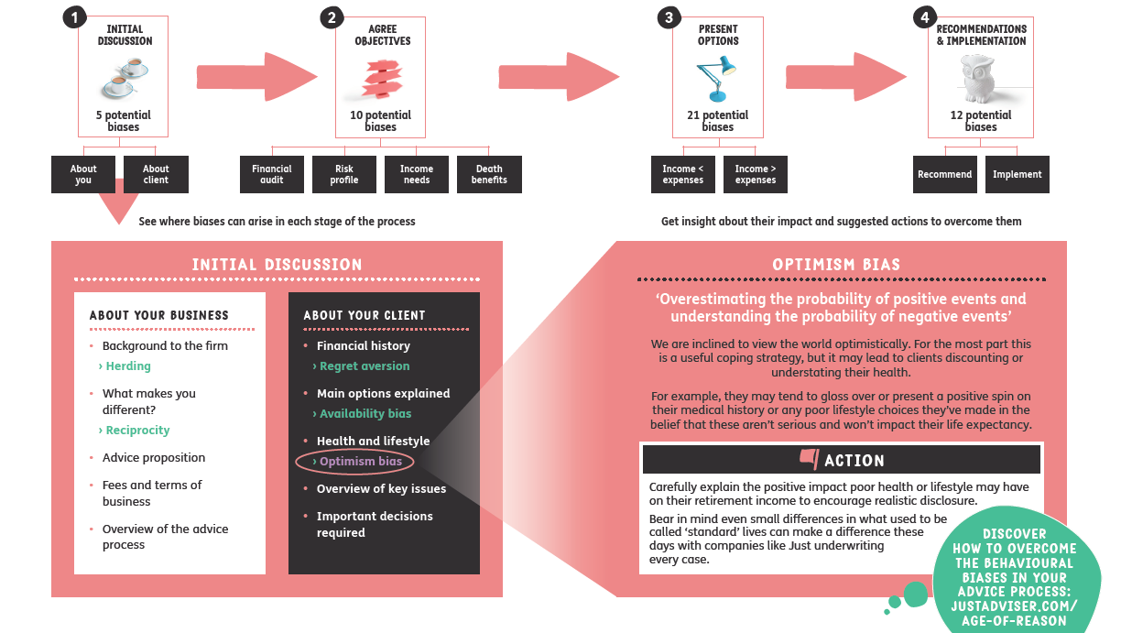
Nudge, nudge..think, think

Slide 35
Meanwhile, back in the real world..
“We regulate for the real world and wherever possible our approach will be based on what we know about how consumers really behave”.
FCA 2017
FCA: Our Future Approach to Consumers 2017
For financial intermediary use only, not to be used with customers.
Notes:
Page 8 http://workspaces/dms/sources/jrsjrl/_layouts/15/DocIdRedir.aspx?ID=SRCID-11-6816

Slide 36
Learning outcomes
By attending this session, delegates will be able to:
Identify key common behavioural biases
Discuss the regulatory concerns
Recognise where biases may be presented in the advice process
Explore ways in which good practice can positively use the impact of behavioural research

Slide 37
Important information
It is our intention that the information contained within this presentation is accurate. We have taken all reasonable steps to ensure that it is up-to-date and, where relevant, reflects the current views of our experts. However, we do not accept any liability for errors or omissions in the information supplied and if you require clarification on anything, our recommendation is that you contact us at the address below for verification, or call 0345 302 2287.
Our registered address:
Just Group plc Vale House, Roebuck Close, Bancroft Road, Reigate, Surrey RH2 7RU
Regulatory information:
Just is a trading name of Just Retirement Limited (“JRL”), Just Retirement Money Limited (“JRML”), Partnership Life Assurance Company Limited (“PLACL”) and Partnership Home Loans Limited (“PHLL”) which are subsidiary companies of Just Group plc. JRL is registered in England and Wales, with company number 05017193.
JRML is registered in England and Wales, with company number 09415215. The registered office for both JRL and JRML is Vale House, Roebuck Close, Bancroft Road, Reigate, Surrey, RH2 7RU.
PLACL is registered in England and Wales, with company number 05465261. PHLL is registered in England and Wales, with company number 05108846. The registered office for both PLACL and PHLL is 5th floor, 110 Bishopsgate, London EC2N 4AY. JRL and PLACL are authorised by the Prudential Regulation Authority and regulated by the Financial Conduct Authority and the Prudential Regulation Authority.
JRML and PHLL are authorised and regulated by the Financial Conduct Authority. Calls may be monitored and recorded, and call charges may apply.
@Just_Adviser
Follow the updates on us on twitter
www.justadviser.com
Our dedicated intermediary site packed with useful calculators, guides, product information, topical articles and more.

Slide 38
How are your clients behaving?
For financial intermediary use only. Not approved for use with customers.

