Slide 1

Financial literacy
“It is a truth universally acknowledged, that a person in possession of a good fortune, must be in want of financial literacy skills”
With apologies to Jane Austen
Notes:
Allow space for individuals to add company logo- also needs CISI logo. Quote taken from Pride and Prejudice “It is a truth…, must be in want of a wife”

Slide 2

Why is financial literacy important?
Half of UK adults need urgent help managing their money
As the cost-of-living crisis bites, consumers say better financial education would reduce indebtedness
How do you get into debt?
What is debt?
Notes:
Open discussion about what it means. Financial Times article 2023.

Slide 3
How many of you have ever made a budget plan or savings plan?
How many of you have ever received pocket money or an allowance?
What do you spend your money on?
Who has considered what will happen when you retire?
Who has a part time job?
Who knows what deductions you’d expect to see on a payslip?
Do you have any idea how much interest you’d expect to pay on:
- A student loan?
A store card?
A credit card?
A mortgage?
Notes:
This can be done using mini whiteboards, hands up, stand up for yes/ sit down for no etc.

Slide 4
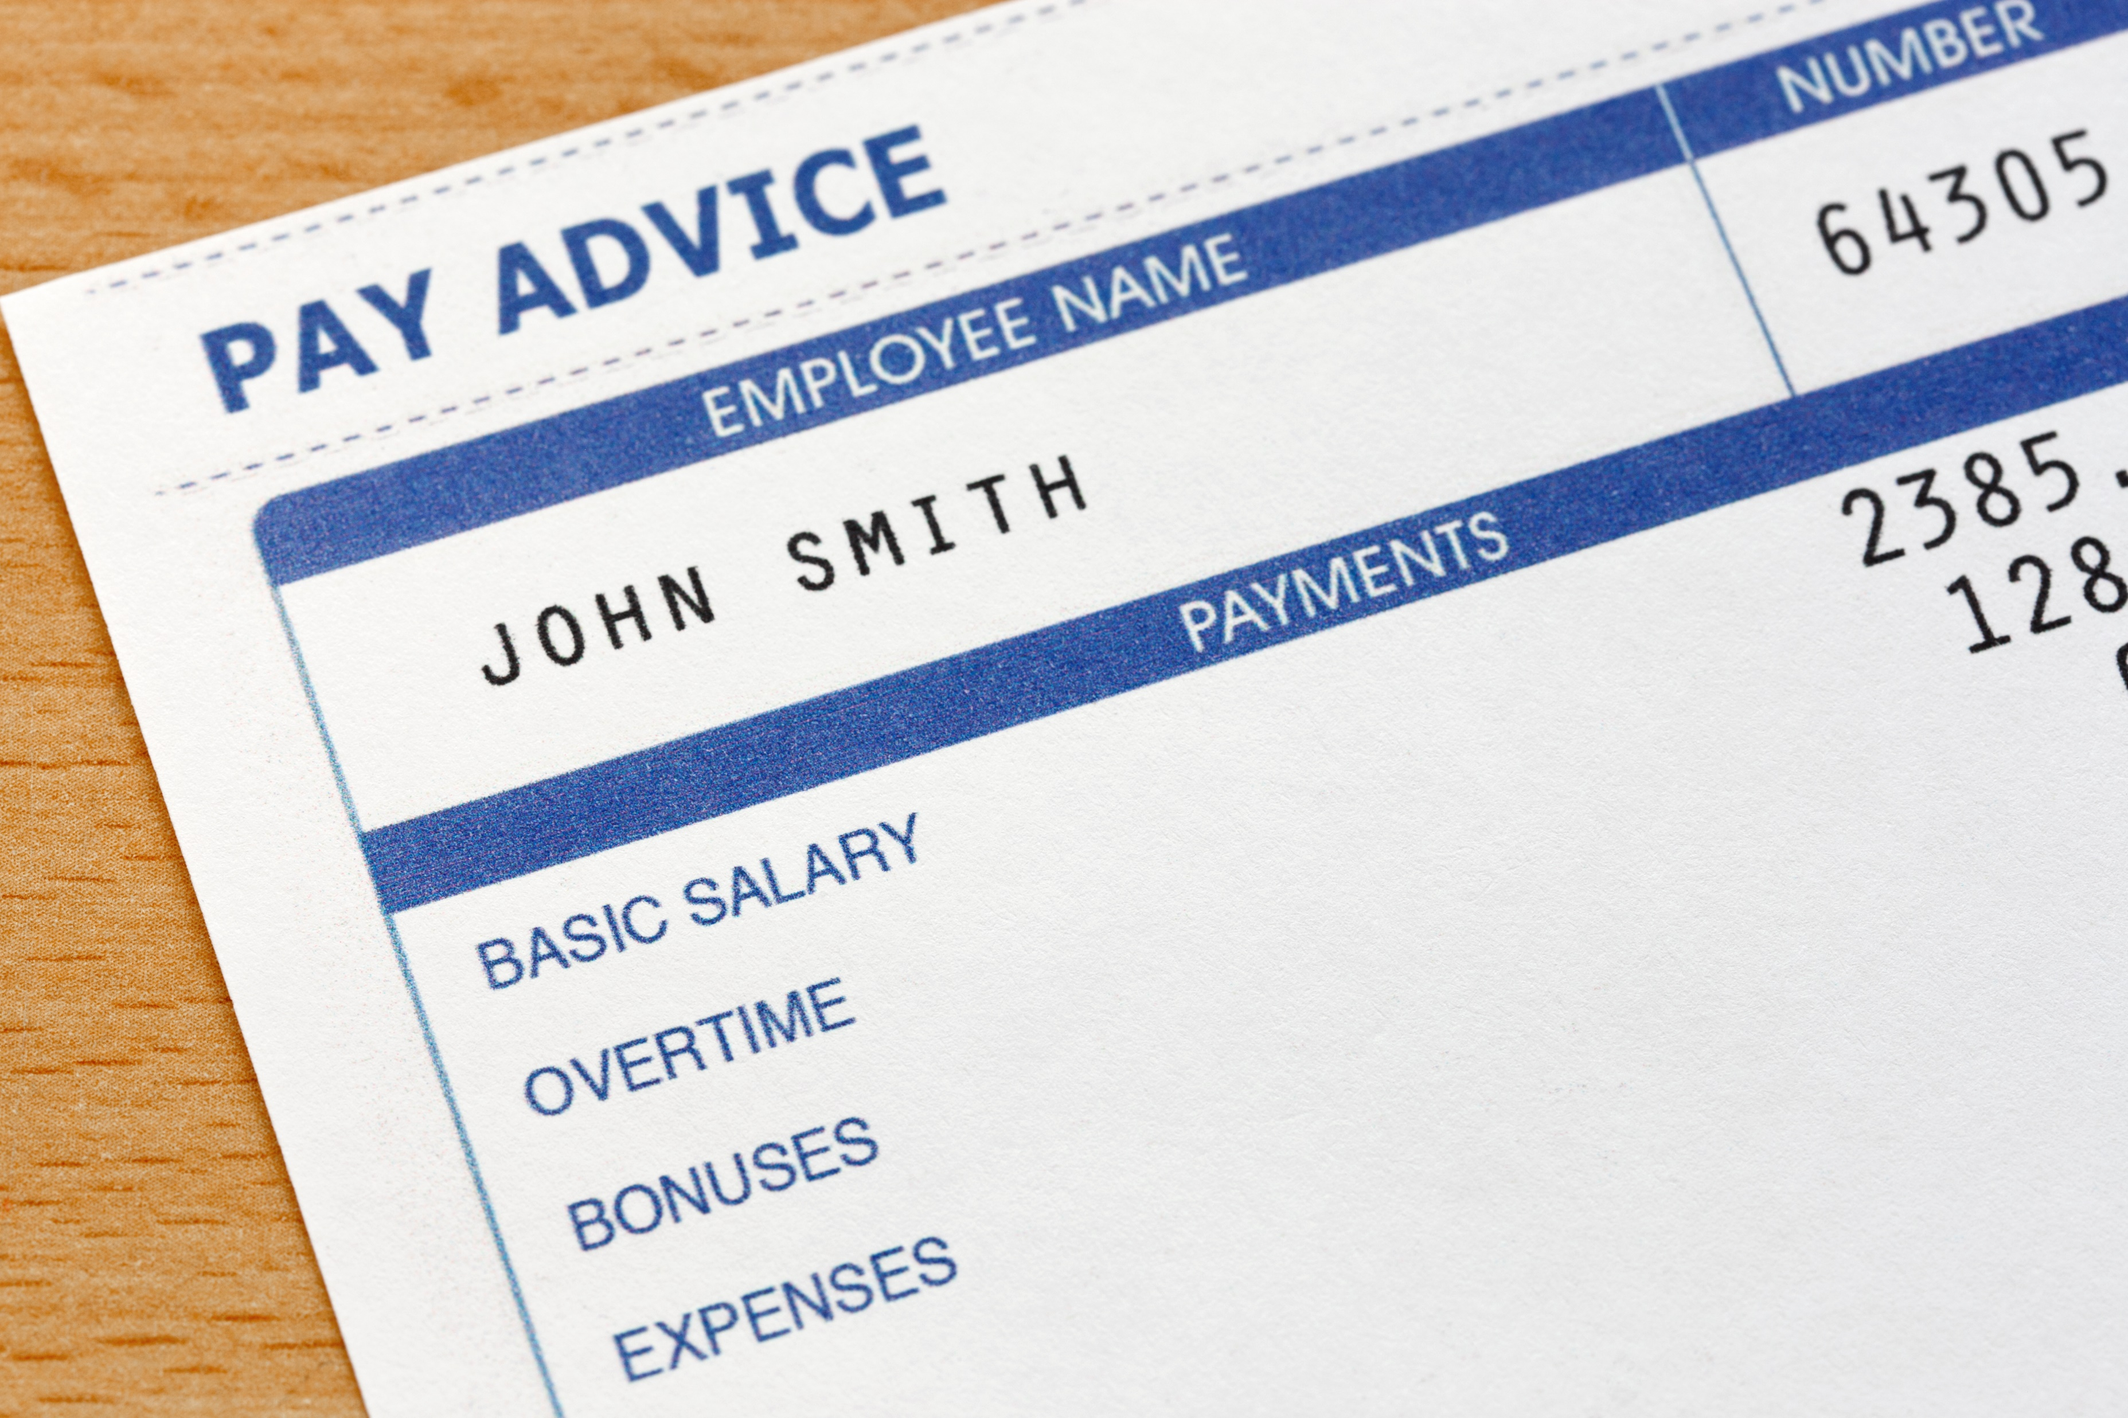
1. Payslips and Outgoings

Slide 5
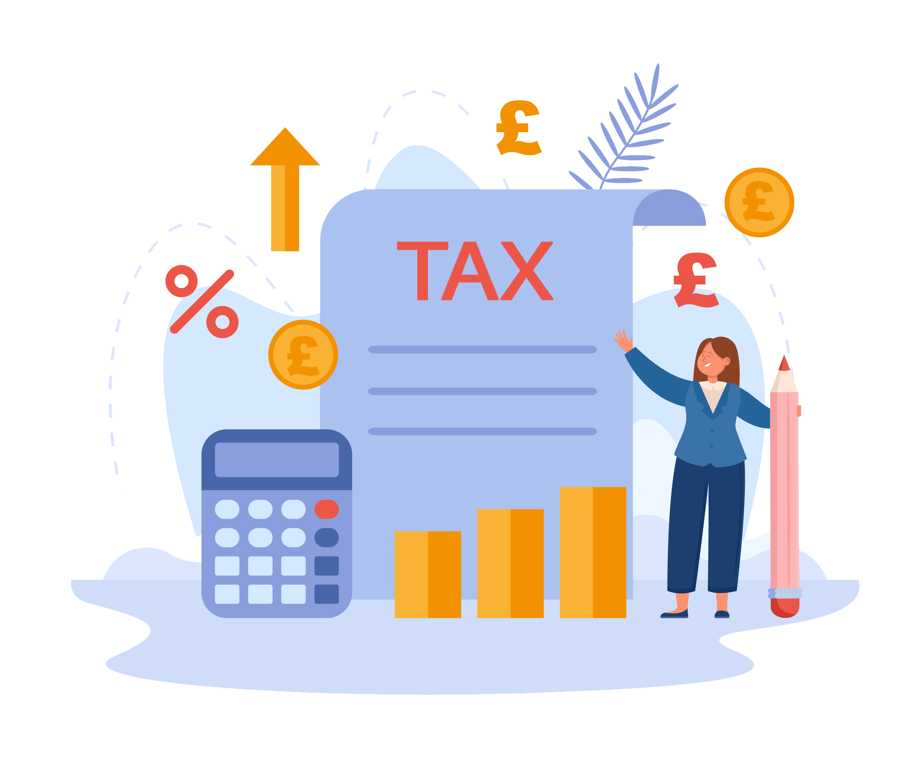
Tax
How much tax do you pay?
£12,570- personal allowance (tax-free)
£12,570- £50,270- 20% tax
£50,271 and £150,000- 40% tax
£150,000 + - 45% tax
You also pay 12% National Insurance on your earnings.

Slide 6

Jadon Sancho earns £350,000 a week
or £18,200,000 a year.
How much tax should he pay?
Who can work this out first?
45% of 18,200,000

Slide 7
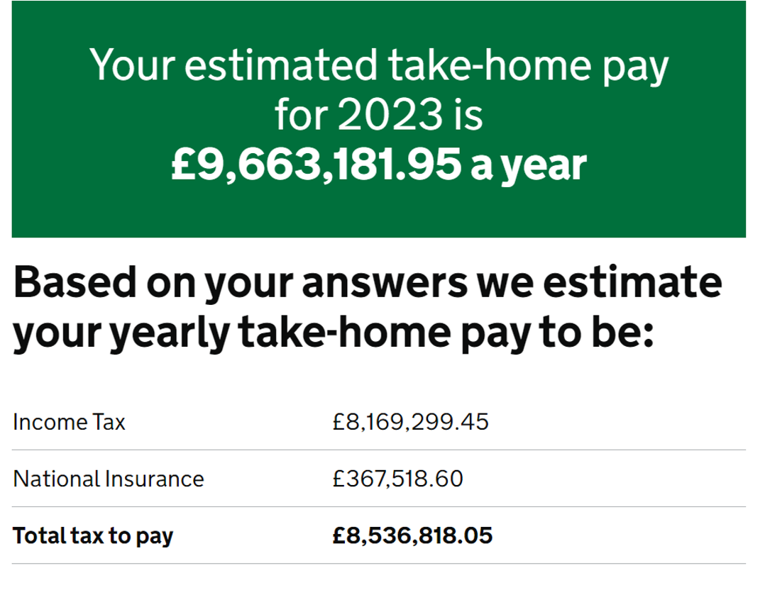
Not bad!

Slide 8

Did you know?
The average household consumer debt in the UK has reached £7,854. Plus, they owe another £4,912 in student loans and £51,241 in mortgages.
That’s a whopping £64,007 in debt!
How do you think you can avoid this?
Is this unavoidable?

Slide 9
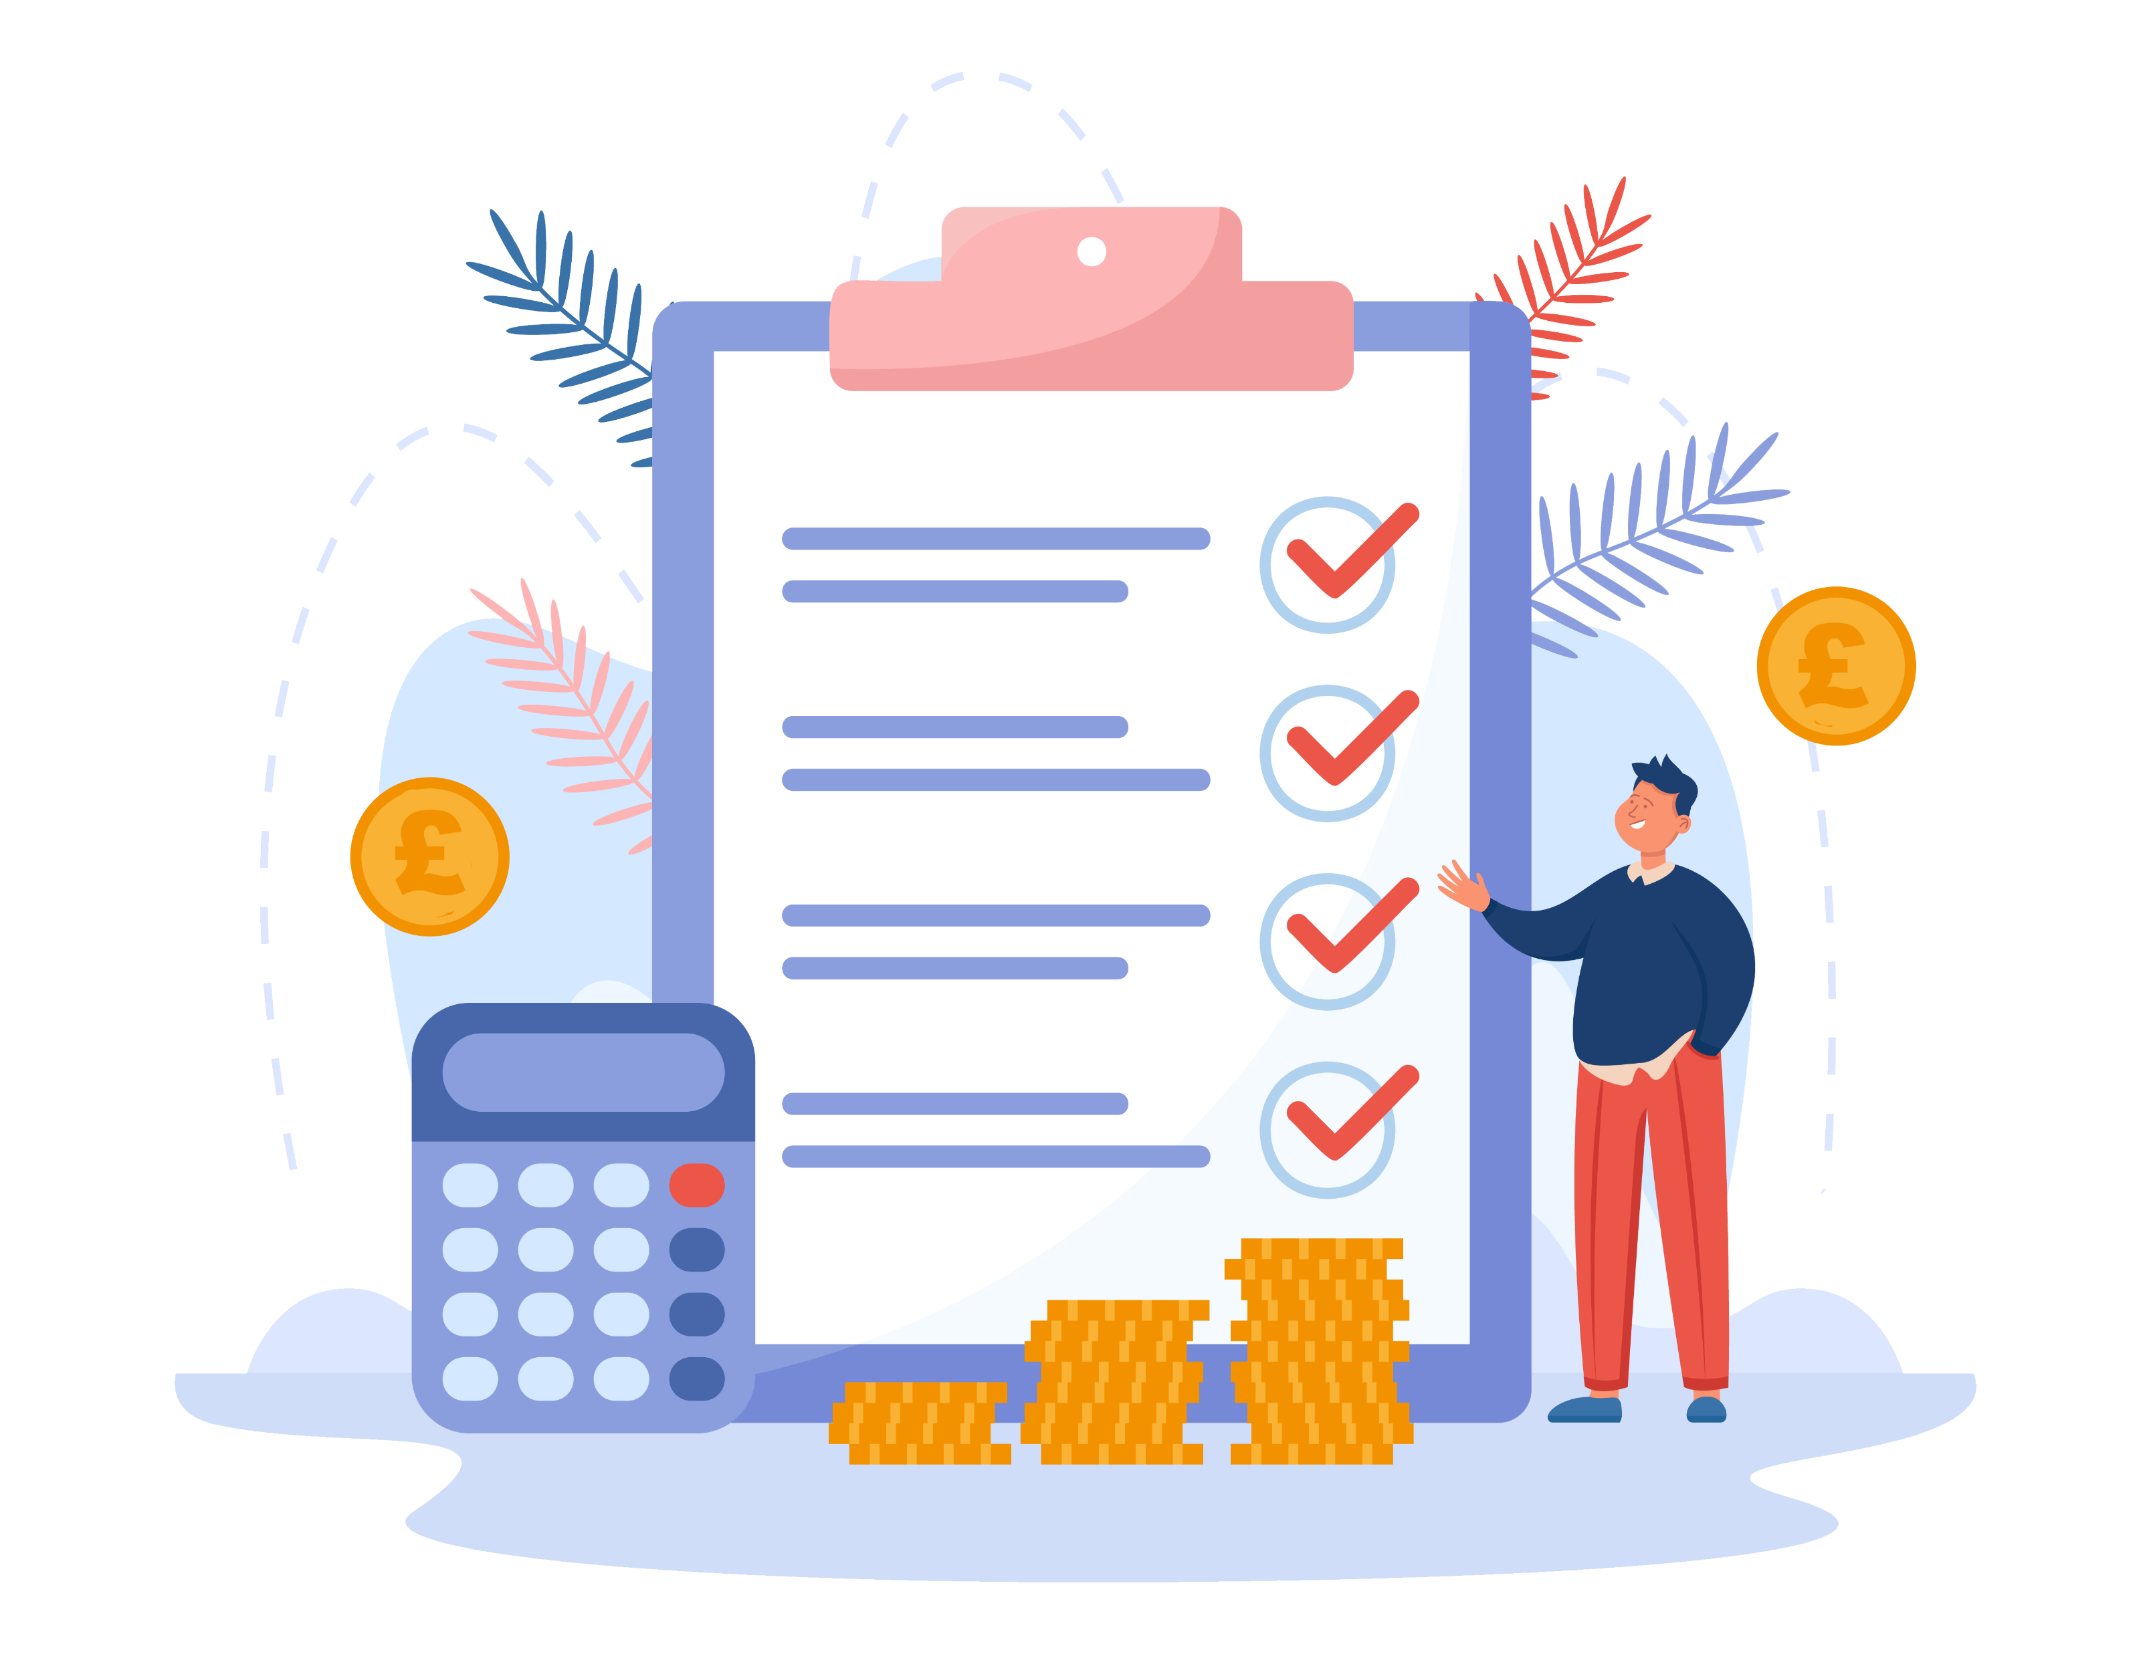
Saving and Budgeting
According to a survey by the Money Advice
Service in 2020, only 41% of UK adults stick
to a budget.
Budgeting is an essential tool for managing
your finances. What does it involve?
Income
Outgoings
What’s left?
A simple budget compares what you have coming in with what you have going out. This will help you avoid overspending and ensure you have enough money to cover the necessities.

Slide 10
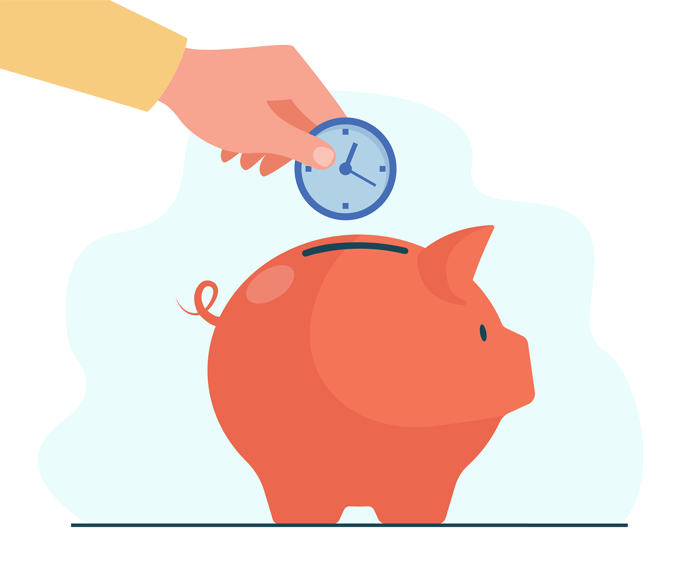
How many of you have savings?
Saving is equally important.
Scenario…
In a situation where someone has budgeted but their car breaks down and costs £1,000, where does the money come from? What are the options?
E.g. credit card, bank loan, dad..

Slide 11
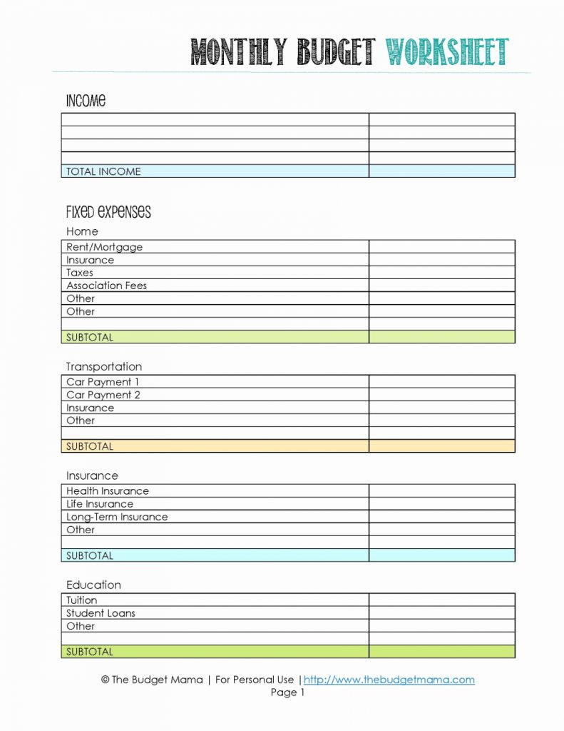
What might a budget look like?

Slide 12
List your regular income, such as allowances, part-time jobs wages or any other sources of money.
Make a list of your regular expenses, such as rent, food, transportation, and entertainment.
Track your spending for one month to get a clear picture of where your money is going.
Compare your income and expenses to see if you have any money left over each month.
If you’re spending more than you’re earning, look for areas where you can cut back and reallocate the savings towards paying off debt or building an emergency fund.
Notes:
This can be done using mini whiteboards, hands up, stand up for yes/ sit down for no etc.

Slide 13

What are the benefits of budgeting and saving?
Improved financial security
Reduced stress and anxiety
Better control over spending
Increased ability to save for the future
Improved credit score
Notes:
This can be done using mini whiteboards, hands up, stand up for yes/ sit down for no etc.

Slide 14
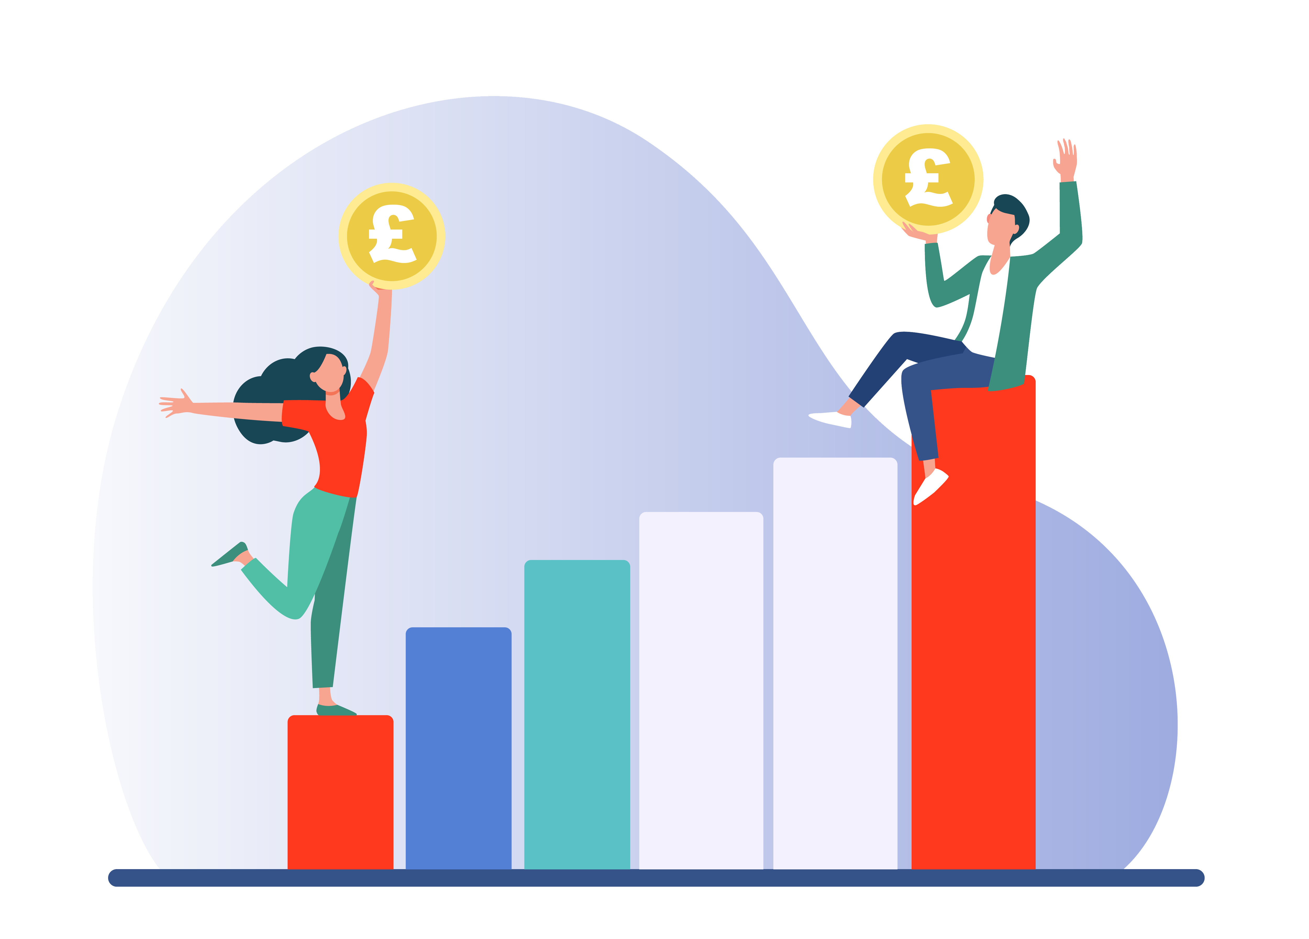
2. Investing
Investing is the process of putting your money into various financial products, such as stocks, bonds, and mutual funds, with the goal of growing your wealth over time.
According to the ONS (Office for National Statistics) only 37% of UK adults have invested in stocks, shares or funds.
Notes:
Could have a discussion about why they think this is the case? Do people not have spare money or is it because they do not know what they are doing?

Slide 15




Types of investments
Stocks Bonds Mutual Funds Real estate
Notes:
Presenter to briefly discuss each one and invite audience to discuss the pros and cons of each or which they have heard of

Slide 16
What are the benefits of investing?
Potential for higher returns than savings accounts
Opportunity to diversify your portfolio and reduce risk
Opportunity to grow wealth in long term
Potential to generate passive income through dividends or rental income
Notes:
This can be done using mini whiteboards, hands up, stand up for yes/ sit down for no etc.

Slide 17





Other big financial decisions

Slide 18
University
How much does it cost to send a student to a UK University each year?
£9,250
13,700
18,800
25,000

Slide 19
University
How much does it cost to send a student to University each year, bearing in mind:
Tuition fees
Accommodation
Living costs

Slide 20
University
How much does it cost to send a student to University each year, bearing in mind:
Tuition fees £9,250
Accommodation £4,900
Living costs

Slide 21
University
How much does it cost to send a student to University each year, bearing in mind:
Tuition fees £9,250
Accommodation
Living costs

Slide 22
University
How much does it cost to send a student to University each year, bearing in mind:
Tuition fees £9,250
Accommodation £4,900
Living costs £4,650

Slide 23
University
How much does it cost to send a student to University each year, bearing in mind:
Tuition fees £9,250
Accommodation £4,900
Living costs £4,650
Total £18,800

Slide 24
University
How much does it cost to send a student to a UK University each year?
£9,250
13,700
18,800
25,000

Slide 25
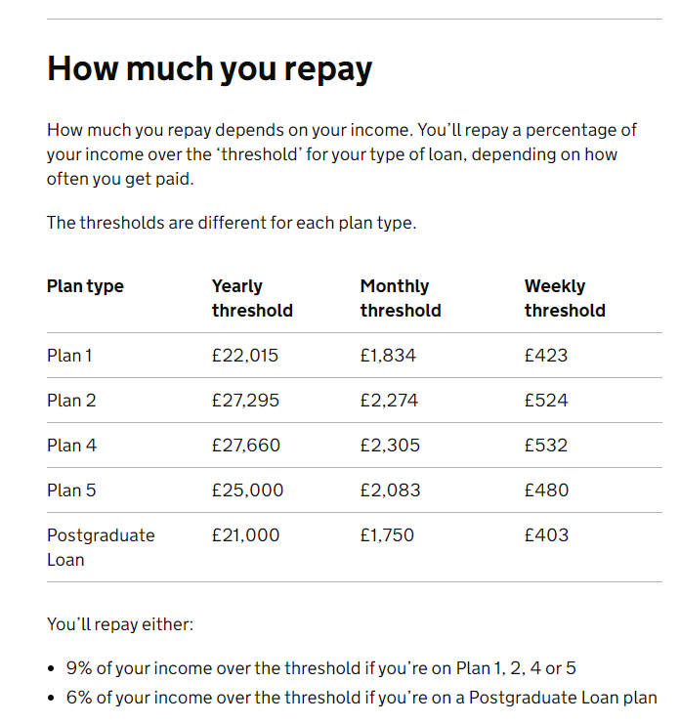
University
Loan

Slide 26
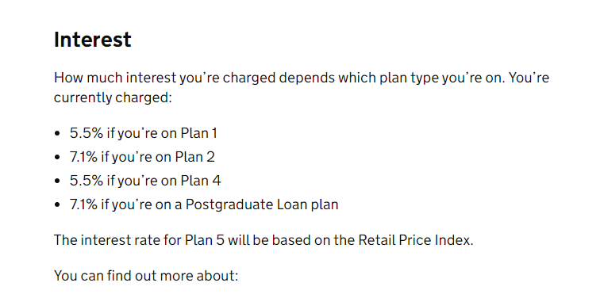
Loan interest rate

Slide 27

When are you likely to have paid it off?
What age do you think you will have paid off your student loan?
A) 25
B) 30
C) 35
D) 40+

Slide 28

It can take up to 40 years!
So, if you graduate at 21, you can still be paying it off when you’re 61!
Although the average is 32, many carry it well into their 40s.

Slide 29

3. Insurance
According to the Association of British Insurers, there are over 200 million insurance policies in the UK.
What do you think they are?

Slide 30



Health
insurance
Life
insurance
Property insurance
Car
insurance
Travel
insurance
Which do you think is the most popular, and why?
Which do you think is the most expensive, and why?
Which are less common?
Notes:
Car insurance- as it’s illegal to drive a car without it.

Slide 31

Housing
Rental vs Mortgage
Average rental vs Average mortgage
(A lot more currently with the high interest rates!)
£695
(£1,500 - £1,600 in London)
£795
(£849 in London)

Slide 32


Freehold or Leasehold?
Leasehold vs freehold is a comparison of two types of ownership of property and land.
In leasehold, the owner has the right to use the property for a set period, but not the land it's built on.
In freehold, the owner has the right to use the property and the land it's built on for as long as they want.

Slide 33
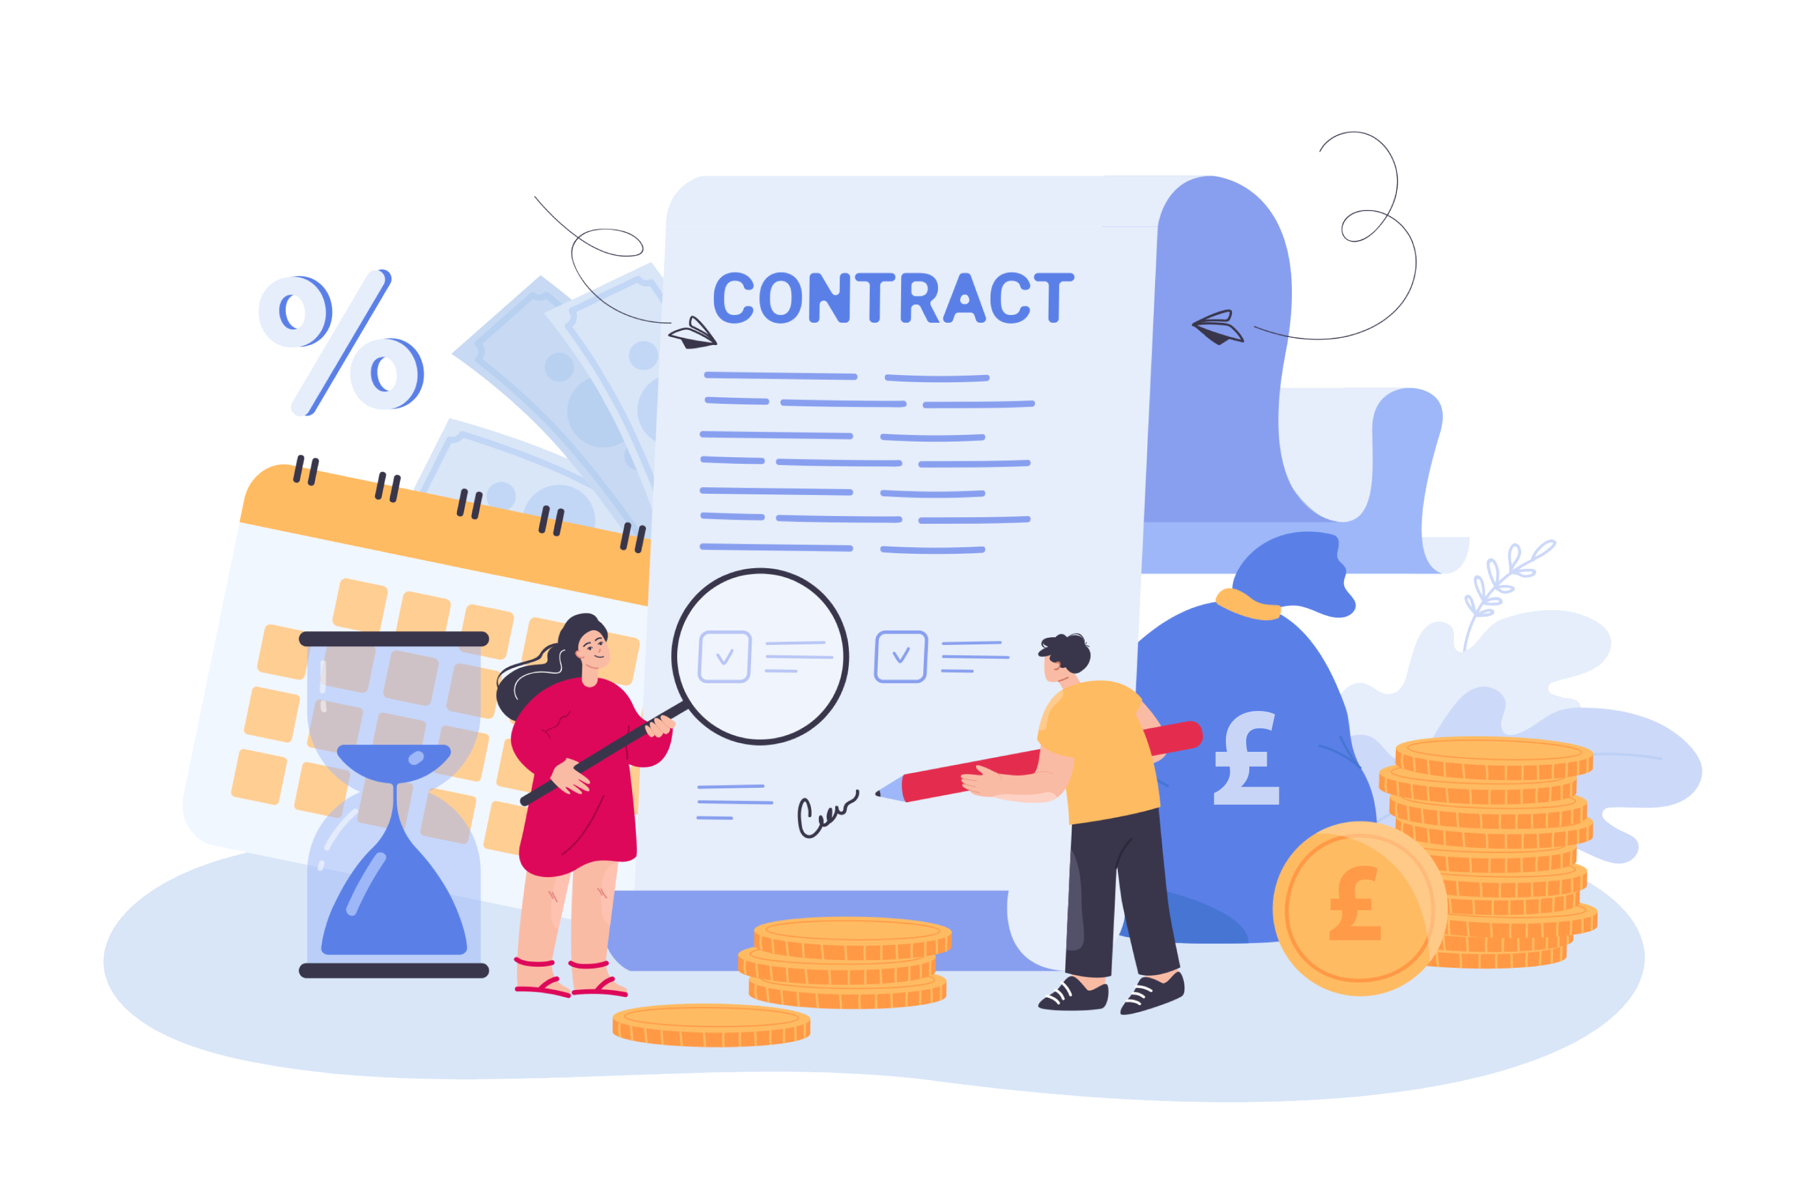
Types of mortgage available
Fixed-rate
Variable- rate
Discount Mortgages
Tracker Mortgage
Capped rate Mortgage
Offset Mortgage
Buy to let mortgage
Second Mortgage
(using the first home as security)
Commercial Mortgage

Slide 34
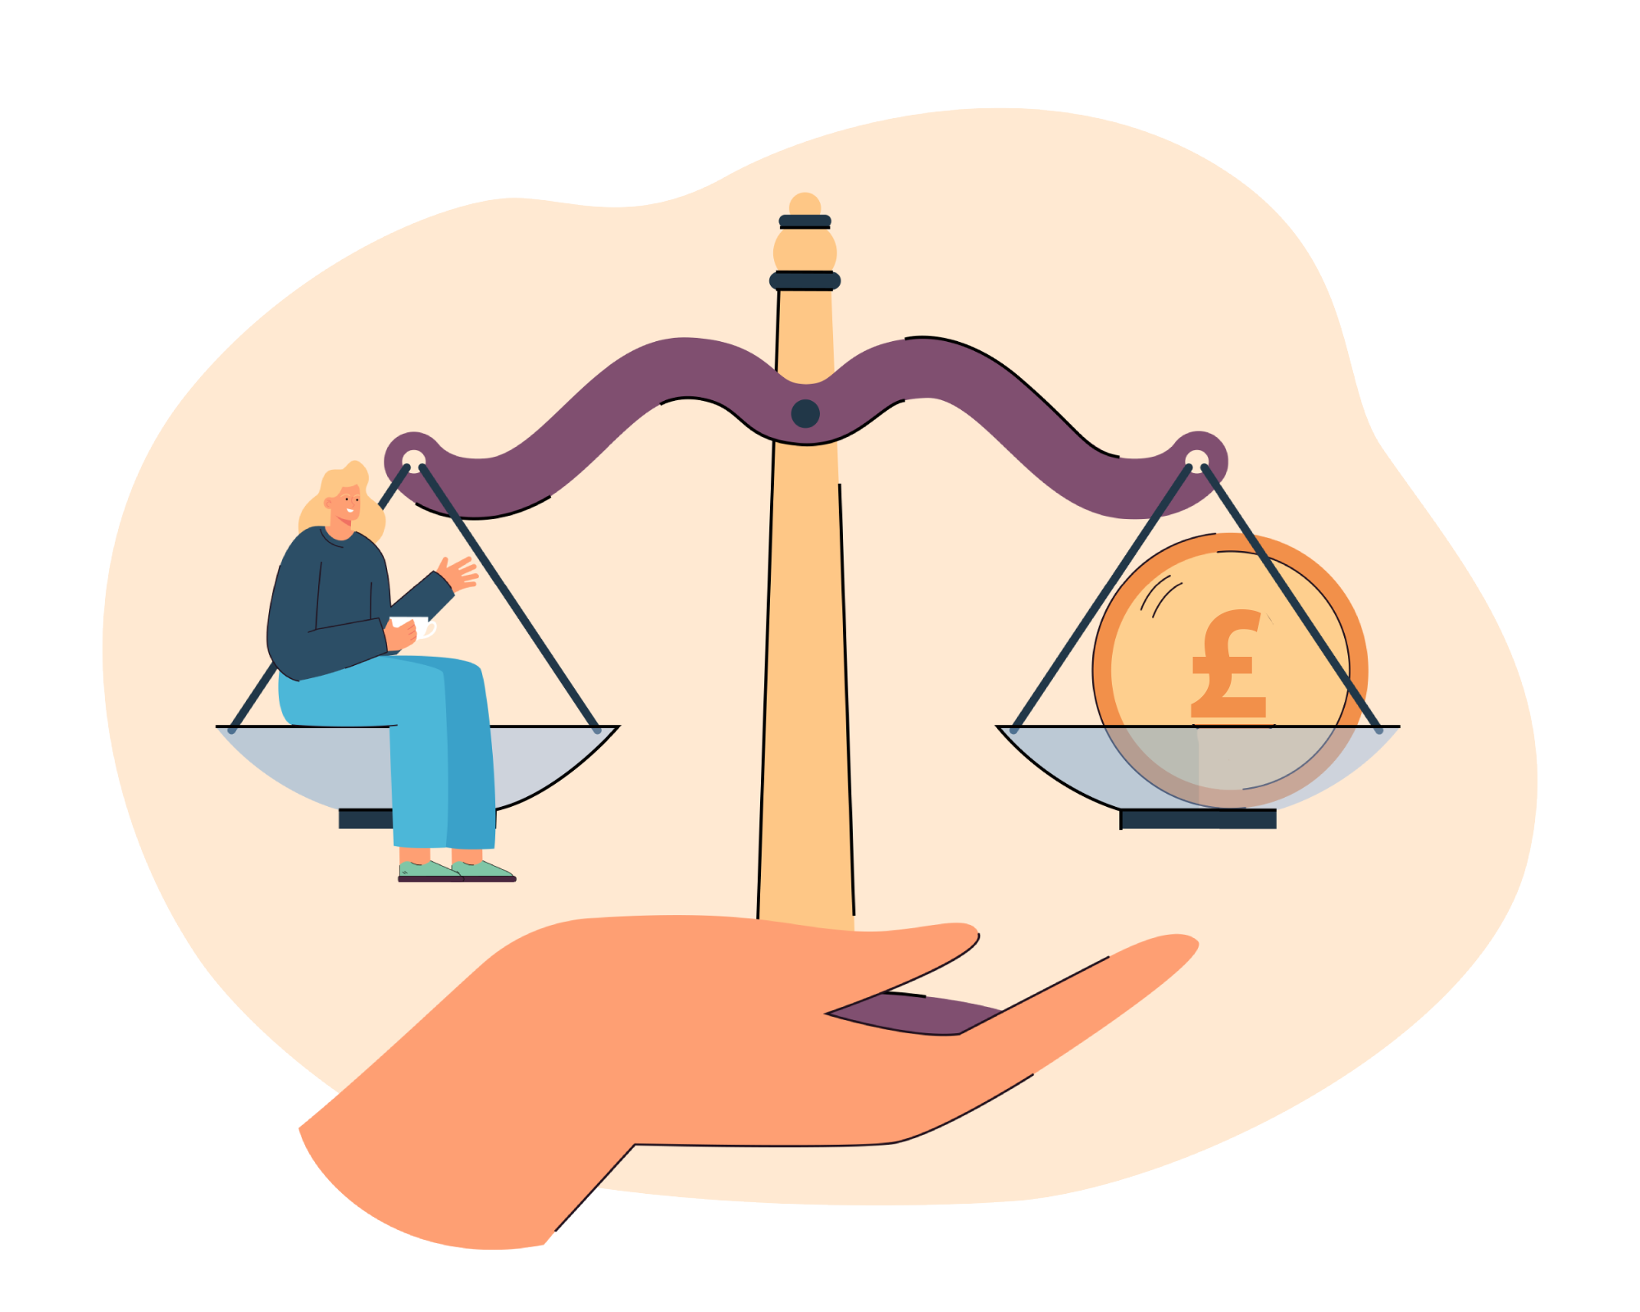
How much can you borrow?
That depends on…
Your age!
Your total household income
The value of the property
The lender’s estimate of what you
can afford
How secure your job is
Your credit score
How much deposit you have
(typically, 20-25% will get you
a good mortgage deal)

Slide 35

Deposits
What is the average deposit
for a house in the UK?
Average UK house price
in Jan 2023 was £258,297
The average deposit (2023)
is £61,000
That’s a lot of budgeting!

Slide 36
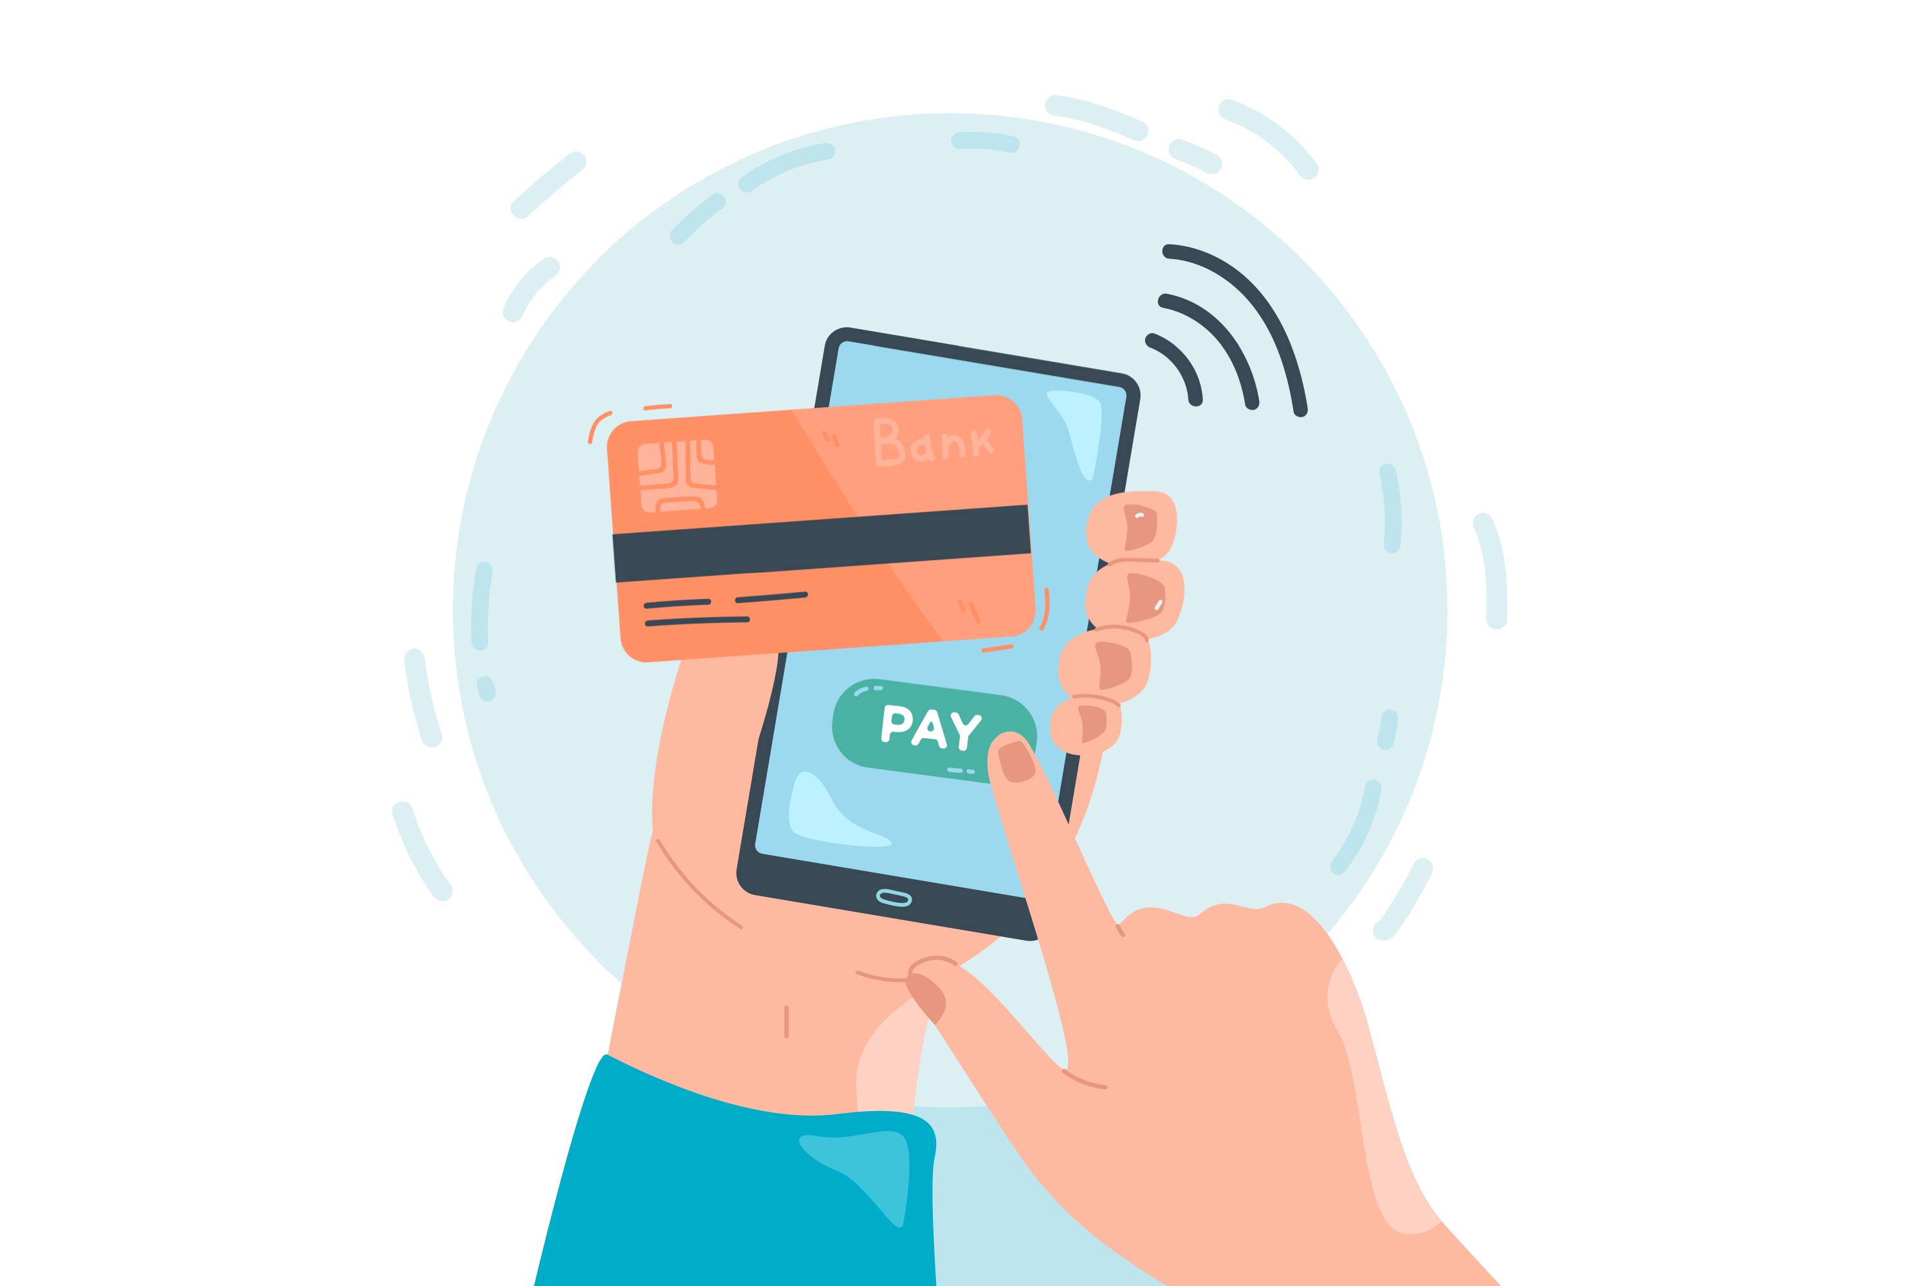
Credit cards and Store cards
Scenario:
You go into your favourite clothing store and spend £200 on clothes. At the till, the store assistant offers you an interest-free store card, which means you will pay nothing today. As a thank you for taking out a store card, you get 20% off, so you have actually saved yourself £40.
Do you:
Say “yes!”
Say “no thanks”
Notes:
Get class to vote/ move to a different side of the room then ask them why

Slide 37
Let’s look at both options
A) The store card
Advantages
Disadvantages
You save £40
You have £200 extra this month than you thought as you have 4 weeks to pay it off
You can pay off in instalments so won’t notice it
You can use it in the future when needed
You will be charged 28% interest if you do not pay it off in one go
You have to be disciplined to pay it all off
You may be tempted to spend a lot more next time as you have a limit of £1,000

Slide 38
B) No store card
Advantages
Disadvantages
You are less likely to get into debt
You will not have to pay any interest
You learn the value of purchasing what you can afford
You don’t save £40

Slide 39

What is compound interest?
Compound interest is the interest earned on the initial amount plus any interest that has already accumulated. It's often described as "interest on interest," which can make savings grow faster and loans more expensive over time.

Slide 40
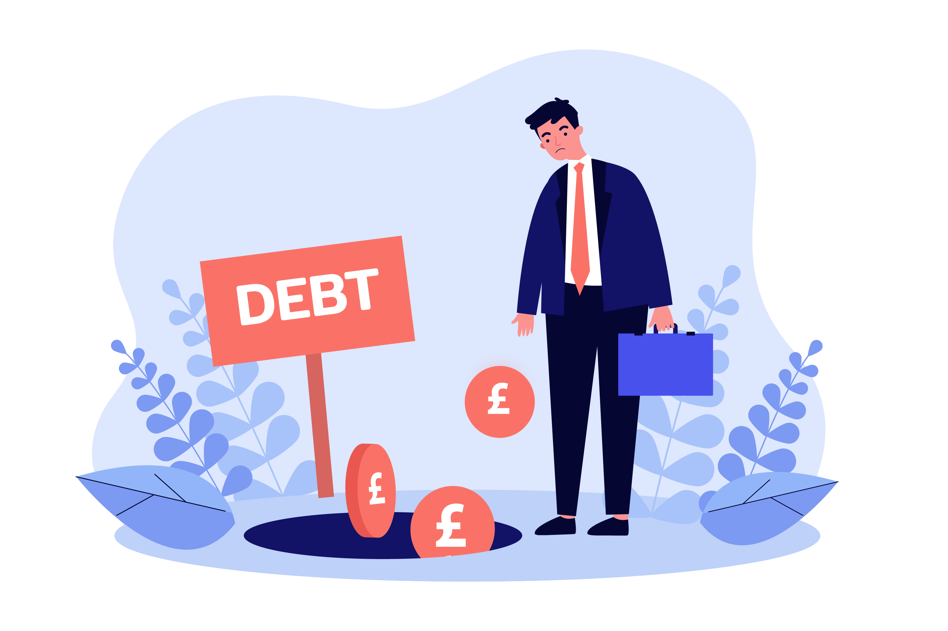
Compound interest also applies to debt
If you do not pay off the total balance, interest will be added, and the total amount you have to pay back will continue to grow!

Slide 41

Conclusion
Key thoughts from today…
Q+A

