Slide 1
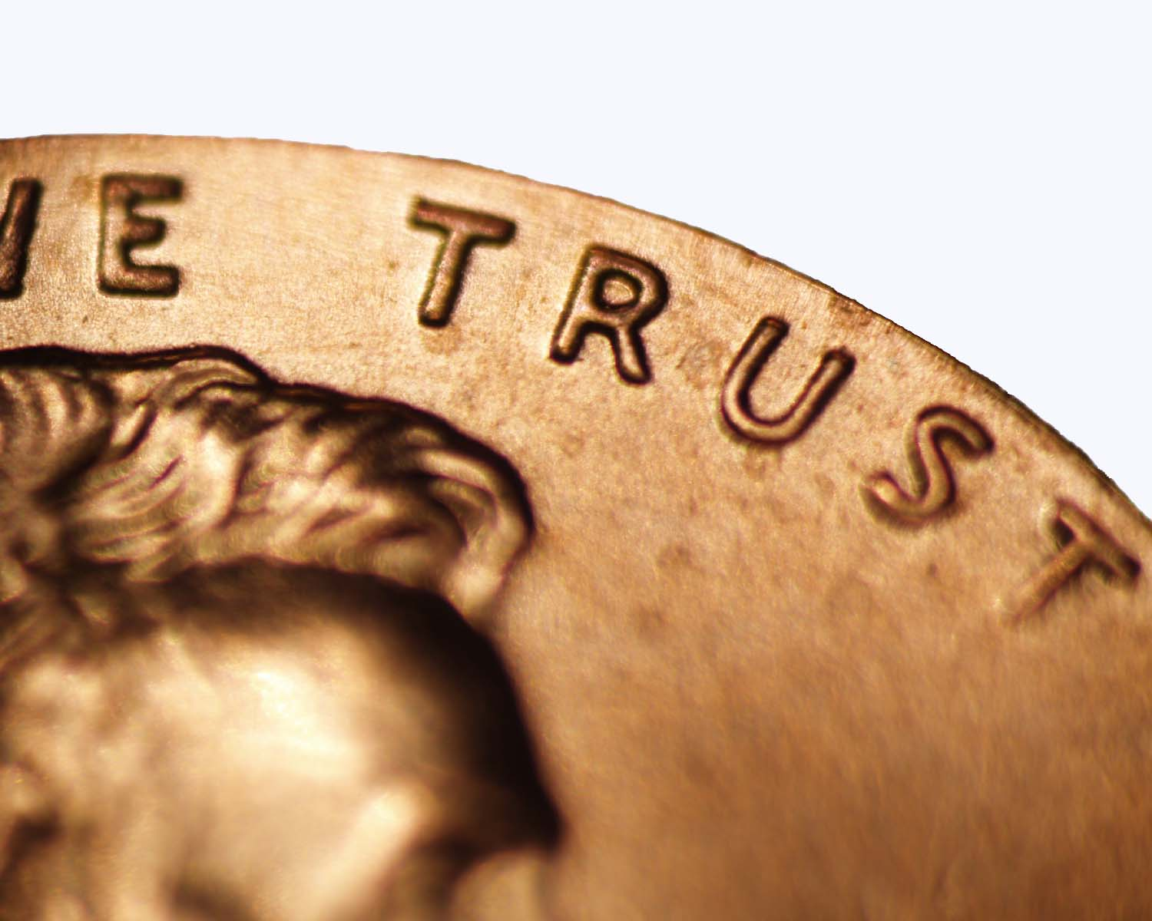

CISI – Financial Products, Markets & Services
Topic – Investment Funds
Lesson: Unit Trusts and Open Ended Investment Companies (OEICs)

Slide 2
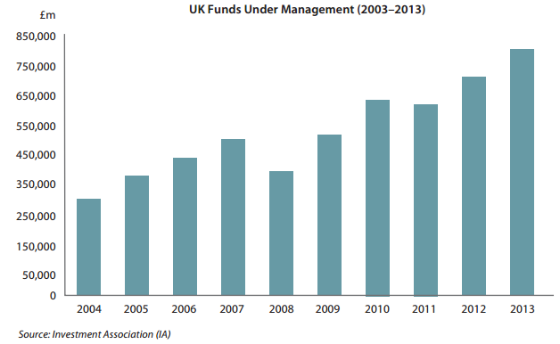
What are unit trusts?
A unit trust is a collective investment scheme. The scheme is in the form of a trust.
A trust is a particular type of entity that is often used to hold assets such as investments on behalf of another person, or group of persons.
The unit trust industry started in 1931, when M&G launched the first unit trust.
Today the industry manages £3trn in over 2,000 funds across over 30 different investment sectors.
In March 2010, assets under management in British unit trusts and OEICs passed £500bn for the first time. This capped a decade where open-ended products doubled their assets under management.

Slide 3



What are Unit Trusts?
Each unit trust may be authorised and marketable to retail investors, or unauthorised and restricted in the way it is marketed.
A UK collective investment scheme such as a unit trust must be authorised by the FCA before it can be offered to the general public.
Open-ended collective
investment schemes
If the portfolio increases in value, the value of the units will increase.
The investors’ money is invested in a diversified portfolio of assets, usually consisting of shares or bonds or a mix of the two.
Unit Trust
Investors
The portfolio might fall in value, in which case the units will decrease in value.
UNITS
Each trust can grow as more investors buy into the fund, or shrink as investors sell units back to the fund and they are cancelled.
Investors pay money into the trust in exchange for units.
Investors can buy into the fund and sell their units back to the fund

Slide 4

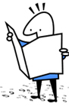

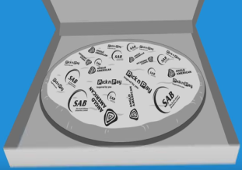

Structure of a Unit Trust
TRUSTEES
Collects and distributes
income from trust
assets
Issues unit
certificates to
investors
Holds and
controls the
unit trust’s
assets
Approves any
advertisements
and marketing
material
BENEFCIARIES
INVESTMENTS
UNIT TRUST
Purchase
units
Holds different
types of assets
- could be shares,
bonds or both
Receives
income
Values and fixes the
price of units
Sells the units
to investors
Buys and sells
investments
Purchases units back
from holders wishing
to sell
Delegates day-to-day
Investment decisions to
separate fund managers
UNIT TRUST MANAGER

Slide 5

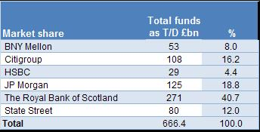
The role of the Trustees
Every unit trust must appoint a trustee.
The trustee is the legal owner of the assets in the trust, holding the assets for the benefit of the underlying unit holders.
The trustee has an important policing role, ensuring that the manager complies with the terms of the legal document that created the trust, the ‘trust deed’.
In most cases, the role of the trustee will be carried out by either a bank, or an insurance company. These trustees are organisations that the unit holders can ‘trust’ with their assets because they are heavily regulated financial institutions.
2010 UK Unit Trust Trustees by market share
Source: R&M Surveys

Slide 6

The role of the Unit Trust Manager
Pricing Units
As already seen unit trust managers are responsible for pricing units to sell to or buy back from investors.
The prices at which units are bought and sold in an authorised unit trust are based on the value of the fund’s underlying investments:
Known as the Net Asset Value or NAV
Pricing Methodology
The authorised fund manager is given certain flexibility in relation to the prices quoted to investors.
All funds now have a choice of which pricing methodology they use; whichever is chosen must be disclosed in the fund’s prospectus.
£10
Offer Price:
Price that investors are quoted to buy units
spread
around 5-7%, but are permitted
to widen this gap to as much as
10% if there is a run on a fund
Unit trusts are traditionally dual-priced.
Investors are quoted a higher offer price at which they can buy units and a lower bid price at which they can sell their units back to the manager. The difference between the two prices is known as the spread.
£9
Bid price:
Price that investors can sell units back to the trust

Slide 7


The role of the Unit Trust Manager
Spreads
Unit trusts use the spread between Bid and Offer prices to recoup dealing expenses and commissions paid to brokers.
A list of unit trust prices from Legal & General as of 20.12.2010
Unit Trust Charges
Investing in unit trusts comes at a cost.
Initial charges range from 5-6%
Annual management charges (AMCs) from 0.5- 2%, depending on the type of fund and degree of specialist management and research required.

Slide 8
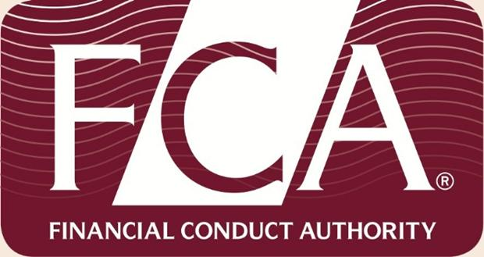
The role of the Unit Trust Manager
Pricing – selling units to the public
The maximum price at which a unit trust manager can sell units to the public is determined by the FCA. It is know as the:
The maximum buying price, which comprises:
  The creation price (NAV plus an allowance for dealing costs)
  The fund manager’s initial charge
Example:
Value of the portfolio (at offer prices) divided by the number of units
  Add allowance for dealing costs (e.g. brokerage at ¼%)
  Add Stamp Duty at ½%
    Sub-total (i.e. creation price)
  Add fund manager’s initial charge (e.g. 6.55%)
Maximum buying price
100.00p
The manager can waive part of the fees in response to sluggish market conditions
0.25p
0.50p
100.75p
6.55p
107.30p
Pricing – buying units back
The bid price at which the fund manager will repurchase units is calculated in a similar manner.
From the investor’s viewpoint it is referred to as the selling price, and the minimum selling price is also known as the cancellation price, using as its starting point the value of the portfolio at bid prices. Again, the manager has some flexibility about the price that is set, subject to its being no less than the minimum selling price.

Slide 9
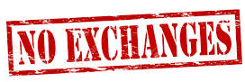
The role of the Unit Trust Manager – Dealing
Investors
All units are bought from, or sold back to the Unit Trust Manager
Units are not bought and sold on stock markets
Unit Trust
Unit Trust Manager
There is no active secondary market in units, except between the investors (or their advisers/ intermediaries) and the fund manager.

Slide 10




The role of the Unit Trust Manager – Dealing
Investors can buy or sell units from the unit trust manager in 3 ways:
Investors
Direct with the Fund Manager
Via their broker or financial adviser
Through a Fund Supermarket
An organisation specialising in offering investors easy access to a range of Unit Trusts and OIECs from different providers. Uses an electronic system platform to place orders with fund managers e.g. EMX
Investors buy and sell units
Unit Trust Manager

Slide 11
Settlement
Settlement currently takes place directly with each fund group.
PURCHASING UNITS
SELLING UNITS
Investor
Investor
Units are purchased
Funds received for investment
Instruct the fund manager (or ask his/her adviser or the supermarket to instruct the fund manager)
Has four days from receipt of the instruction in which to settle the sale and remit the proceeds to the investor
Unit Trust
The fund group will record ownership of the relevant number of units in the fund’s share register.
Unit Trust Manager

Slide 12

What are Open-ended Investment Companies (OEICs)?
Unit trusts are gradually being replaced by their modern equivalent, the Open-Ended Investment Company, or OEIC.
They are also known as:
Investment Companies with Variable Capital (ICVCs) by the FCA
Société d'investissement à capital variable (SICAVs) in continental Europe

Slide 13
Comparing OEICs and Unit Trusts
 | Similarities | Differences
Structure
Management
Supervision
Regulation
Pricing
Both are Open-ended Collective Investments – the fund can both grow and shrink in size as investors buy-in and leave the fund
OEICs are structured as companies – investors buy shares. They have a more simple legal structure
Unit Trusts are structured as trusts – investors buy units in the trust. They have a more complex legal structure
Both have a fund manager responsible for pricing, buying and selling units or shares.
The fund manager in OEICs are known as:
Authorised Corporate Director
The fund manager in a Unit Trust is known as:
Authorised Unit Trust Manager
In both cases, the fund manager can delegate responsibilities to a suitable 3rd party
Both have an organisation or body supervising and policing the actions of the fund manager. They are the legal owners of the fund’s assets and they hold the assets.
In OEICs, they are known as:
Depositary
In an Authorised Unit Trust they are known as:
Trustees
Both are well regulated by the FCA
Both are regulated by the FCA on pricing units or shares
This is the main difference between the two:
Unit Trusts use dual-pricing – bid and offer prices creating a spread. Fees and charges are hidden in the spread.
The fund manager has the ability to set prices to an extent
OEICs use a single price directly linked to the value of the fund's underlying investments. They are more transparent about management fees.

Slide 14
Comparing OEICs and Unit Trusts
 | Similarities | Differences
Dealing and Settlement
The same methods of dealing and settlement apply.
Everything is done via the fund manager – exchanges are not used.
Advisers/brokers and fund supermarkets can be used to arrange everything with the fund manager.
Both have a 4 day turnaround for selling shares or units and both have to keep and maintain a register .

Slide 15
OEICs Summary
Authorised Corporate
Director
Depositary
Buys and sells investments within the fund and deals with the day-to-day fund management – valuing the fund and setting prices
The fund is open-ended so it can grow and shrink as investors buy and sell back shares
Open-ended Investment Company
ICVC
SICAV
Investors buy and sell shares in the fund. A single price is quoted when buying or selling shares.
Share prices go up and down based on the value of the underlying assets in the fund
Investors

