Slide 1
CISI – Financial Products, Markets & Services
Topic – Derivatives
(6.3 and 6.4)Options and terminology

Slide 2
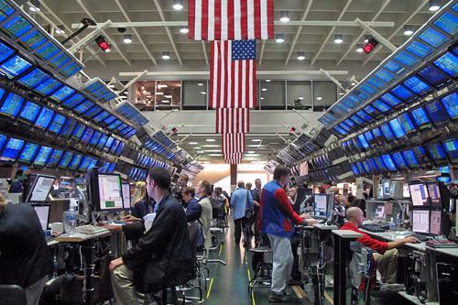
Options
This form of derivative did not come about until 1973, after two US academics produced a pricing model which allowed them to be readily priced.
Standardised options contracts followed, along with the creation of the Chicago Board Options Exchange (CBOE).
This led to the introduction of options onto other exchanges e.g. Liffe

Slide 3
Options – Definition and functions
They grant the option to the buyer.
Also known as the writer of the options.
They receive a ‘premium’ in exchange for the option
Seller
Option
Contract
The right but not the obligation
to buy or sell a specified quantity of an underlying asset at a pre-agreed exercise price, on or before a pre-specified future date or between two specified dates
Known as the holder of the option.
They buy the option in exchange for a ‘premium’
This is paid to the exchange who sends it on to the Writer at the beginning of the option contract (non-refundable)
Buyer

Slide 4
Options – Definition and functions - example
The bank writes an option:
Purchase 1000 shares in ABC plc for £5 per share
For 3-months
Seller - Bank
Option
Contract
The investor:
Pays a premium to the bank for the option
Can decide to exercise the option (buy the shares)
Can decide to let the option lapse
Buyer - Investor
What choice should the investor make?
Depends on the market price of the shares during the period

Slide 5
Options – Definition, Functions and Terms
Over-the-counter (OTC)
Off exchange
Determined by two counterparties
When investors want to trade an option that is outside the standardised terms
A Call option
The buyer has the right to BUY the asset at the exercise price.
The seller is obliged to deliver if the buyer exercises the option
Are there
different classes?
How are
they traded?
Option
Contracts
A Put option
The buyer has the right to SELL the asset at the exercise price.
The seller is obliged to take delivery and pay the exercise price if the buyer exercises the option
On an exchange
Standardised sizes e.g. 1000 shares
Standardised terms e.g. 3 months

Slide 6
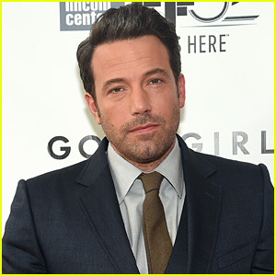
Call Option - Example
The Script Writers
Option
Seller/Writer
Ben and Matt write a 6-month call option for their script. The option grants Castlerock the right to buy the script for £675,000 by the end of the period. They will have to deliver if exercised.
Castlerock buy the call option and pay a premium of £100K to Ben and Matt. They now have the right to buy the script by the set date for the set amount and take delivery if they wish to exercise.
Own the rights to the script
“Good Will Hunting” Script
(Underlying Asset)
The Producers
Option
Buyer/Holder

Slide 7
Put Option - Example
The Script Writers
Option
Buyer/Holder
Castlerock write a 6-month put option for Ben and Matt’s script. The option grants the scriptwriters the right to sell the script for £675,000 by the end of the period. Castlerock will have to buy and take delivery if exercised.
Ben and Matt buy the put option and pay a premium of £100K to Castlerock. They now have the right to sell the script by the set date for the set amount if they wish to exercise.
Own the rights to the script
“Good Will Hunting” Script
(Underlying Asset)
The Producers
Option
Seller/Writer

Slide 8
Options – Naked and Covered Positions
We have seen that in a futures contract, the seller can hold a ‘COVERED’ or ‘NAKED’ position depending on whether they hold the underlying asset needed for physical delivery.
A similar situation exists for an options contract:
Shares in Beckenham Ventures Plc are trading at 125p
Investor Jones writes the call option. Investor Jones charges investor Smith a non-refundable premium of 20p
Investor Smith buys a 150p call option for three months
The writer, Investor Jones hopes that Investor Smith does not exercise the option so he can simply pocket the 20p premium
If the share price starts to rise above 150p, then Investor Smith is likely to exercise the option and buy the shares at 150p
If he already holds the shares, his position is referred to as ‘COVERED’
If he does not hold the shares, this poses a risk to Investor Jones - his position is referred to as ‘NAKED’ and he will have to buy the shares in the market

