Slide 1
CISI – Financial Products, Markets & Services
Topic – Derivatives
(6.1, 6.2 and 6.4)Uses of derivatives, Futures and Terminology

Slide 2
What are Derivatives?
A Derivative is……
A financial instrument where the value is derived from the price of an underlying asset.
The underlying asset could be financial or a commodity.
They have been around hundreds of years – originating back to agricultural markets

Slide 3
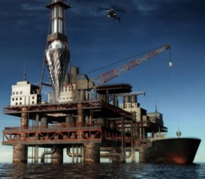
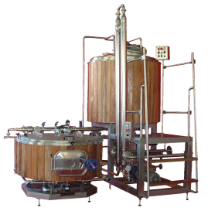
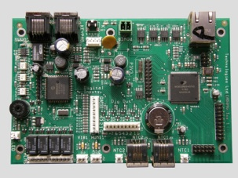
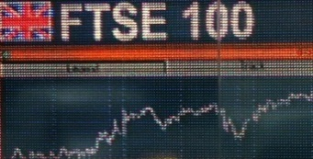
What can be the underlying asset and why are derivatives used?
£
The oil company has a guaranteed buyer and price for the fuel and guards against oil prices falling
The airline has safeguarded against future rises in oil prices
Jet Fuel
£
The brewery has guaranteed hops to produce beer and can guard against increasing hop prices
The farmer has a guaranteed buyer and price for the hops and guards against falling hop prices
Hops
£
The farmer has a guaranteed buyer and price for the wheat and guards against falling wheat prices
The bakery has guaranteed wheat to make products and can guard against increasing wheat prices
Wheat
£
The mining company has a guaranteed buyer and price for the copper and guards against falling copper prices
The manufacturer has the raw materials to produce products and guards against rises in the price of copper
Copper
£
The company will guard against the risk of interest rate rises and an increase in the cost of borrowing
The Investment bank will swap the type of interest rate offered on the company’s borrowings for a fee
Interest rates

Slide 4
Derivatives and their uses
Speculating
The motive of a party is to make money – they have no interest in the underlying asset e.g. Banks
Financial instruments are used to give exposure to price movements
Hedging
Reduces the risk of adverse price movements for the buyer and the seller
FUTURES
FORWARDS
OPTIONS
SWAPS
A Derivative is……
A financial instrument where the value is derived from the price of an underlying asset.
The underlying asset could be financial or a commodity.
They have been around hundreds of years – originating back to agricultural markets
Financial Assets
Bonds
Shares
Stock market indices
Interest rates
Commodities
Oil
Silver
Wheat
Trading of derivatives can take place:
Either directly between counterparts - known as over-the-counter (OTC)
Or, on an exchange - known as exchange-traded

Slide 5
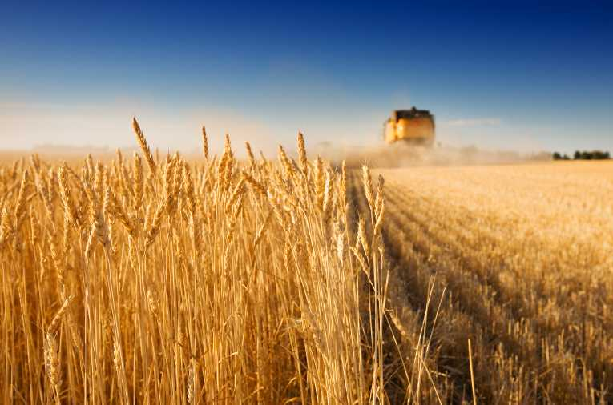
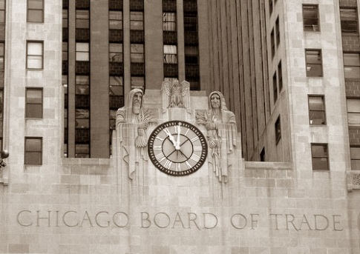
Futures – A history
Derivatives have been around for hundreds of year, traced back to agricultural markets:
Farmers often needed a mechanism to guard against price fluctuations (From produce shortages and droughts)
Farmers and merchants entered into forward contracts before the harvest period – this removed much of the risk previously faced.
Because these they were very popular and led to the opening of the world’s first derivatives exchange, the Chicago Board of Trade (CBOT), in 1848.
The exchange introduced a futures contract. They involved the purchase or sale of:
A standardised quantity
and quality of grain (such as 100 bushels of wheat containing no more than 5% moisture)
for a price agreed now and for delivery on a stated future delivery date, such as three months later.
Unlike the forward contracts that preceded it, these futures contract are traded on the exchange, rather than over the counter.
1975 saw CBOT introduce the world’s first financial futures contract.

Slide 6
Futures – Features
We have already seen examples of futures contracts in the last activity.
2. Agrees to pay a pre-specified amount for the delivery of a pre-specified quantity of an asset at a pre-specified future date (XXX of Jet fuel at £xxx on 10.10.15)
4. Exchange Traded
e.g. NYSELiffe or ICE
1. Futures Contract
It is a Legally binding obligation between two parties
Buyer
Seller
5. Standardised terms
Only the price is negotiable – quality, quantity, date and location is set by the exchange
3. Agrees to deliver the asset (Jet fuel) at the future date, in exchange for the pre-specified amount of money

Slide 7
Futures - terminology
Long
The buyer
Committed to buying the underlying asset at the pre-agreed price at a future date.
Short
The seller
Committed to delivering the underlying asset in exchange for the pre-agreed price on the specified future date.
Naked
The seller of the future does not have the asset that will be needed if physical delivery of the commodity is required.
Seller
Futures Contract
Legally binding obligation between two parties
Buyer
Open
The initial trade.
The trade is ‘opened’ when it first enters a future.
Can be a buyer (Opening a long position) or a seller (Opening a short position)
Close
Most physical assets don’t end up being delivered.
A closing sale is made by the buyer before delivery date.
If it is not closed, the buyer receives the asset.
Covered
The seller has the underlying asset that will be needed for the physical delivery to take place. (Often the seller does not have ownership at the time)

Slide 8
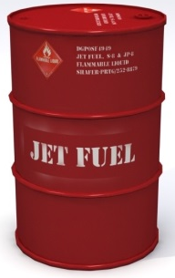
Futures Terminology - Naked and Covered
Naked Position
The seller of the future does not have the asset that will be needed if physical delivery of the commodity is required.
Covered Position
The seller has the underlying asset that will be needed for the physical delivery to take place. (Often the seller does not have ownership at the time)
Seller
If the futures contract is not ‘closed out’, Shell would need to fulfil the delivery of the specified quantity of jet fuel on the date specified at the specified price but would need to purchase the oil to fulfil the contract.
If the futures contract is not ‘closed out’, Shell would need to fulfil the delivery of the specified quantity of jet fuel on the date specified at the specified price. If they are in this position, they already have the asset to fulfil the contract.
Why would a buyer ‘close out’ a futures contract?
It goes back to the purpose of the futures contract and who the buyer is.
In the case of the airline and oil company, the contract is not likely to be ‘closed out’ as the airline has a genuine interest in the underlying asset (jet fuel) – they need it to do business. Both parties are hedging.
But the buyer could be a financial institution speculating on the price of the underlying asset and have no interest in the asset itself, therefore do not want physical possession of it.

