Slide 1
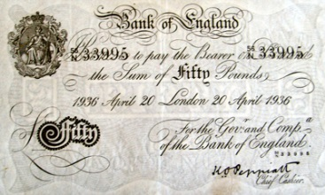
CISI – Financial Products, Markets & Services
Topic – The economic environment
(2.1.7) Economic Data – Budget Deficits, National Debt and Levels of Unemployment

Slide 2
Government Borrowing
Why does the government need to borrow money?
From the Circular Flow of Income, we know that the government receives money through taxation but also has to spend money on various public goods and services.
In your groups, create a mind-map to display the different reasons why you think the government has to borrow money. The video clip you just watched provides some of the answers.
Reasons for government borrowing

Slide 3
Government Borrowing
Why does the government need to borrow money?
Meets a temporary shortfall and gives flexibility
Government spending is stretched and borrowing is necessary
Benefits such as jobseekers allowance can be paid and inequality reduced
Tax revenues may not be as high as predicted
Reasons for government borrowing
War
Recession (Tax revenues fall)
Cheap
Political Pressure
Borrow at lower rates of interest due to confidence. Growth and inflation also reduces the value of the debt
Investment in public services and infrastructure
Lower taxes and higher public spending is more popular than higher taxes and lower public spending
Boosts growth and capacity

Slide 4
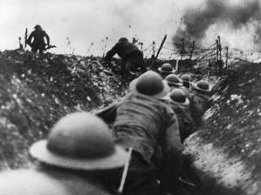
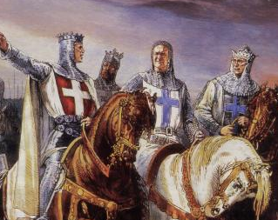
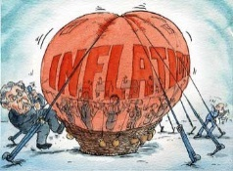
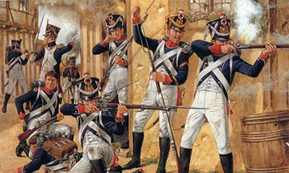
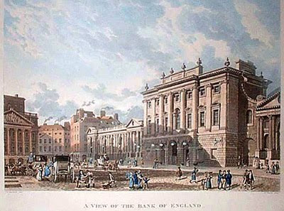
National Debt – a brief history
One of the key functions of government is to manage the public finances and therefore public sector debt , also known as national debt is a key economic indicator.
Overspending and financial crisis/recession
National debt in 2016 around £1,500bn
The state would incur budget deficits as a result of war – funded purely by taxes
The start of World War I
National debt now at £650m
Emergence of banking and financial markets - money could be raised by creating debt – issue of bills and bonds – the start of national debt!
1970s and 80s saw high inflation
National debt now at £197.4bn
Pre 1694
1694
Early 1700s
1815
1914
1919
1946
1988
21st Century
1700 - the national debt was £12m
Post World War II
National debt now at £24.7bn
The Bank of England was established as a result of war with France – first public debt issued in England
The end of World War I
National debt now at £7.4bn
End of the Napoleonic Wars
National debt now £850m

Slide 5
National Debt Economic Indicators
There are a number of measures used to report on national debt but there are two main types:
Government Debt
Quoted as Public Sector Net Debt
Government Deficit
Quoted as Public Sector Net Cash Requirement (PSNCR)

Slide 6
Government Deficit
Quoted as Public Sector Net Cash Requirement (PSNCR)
Formerly known as Public Sector Borrowing Requirement (PSBR)
How is it calculated?
Annual
Government
Income
Annual
Government
Expenditure
-
Mainly generated through taxes (personal and corporate)
Central government
+ local government
+ public corporations
What does PSNCR actually tell us?
The difference between government expenditure and income.
It shows how much the government needs to borrow on an annual basis through the issue of government debt (bonds).

Slide 7
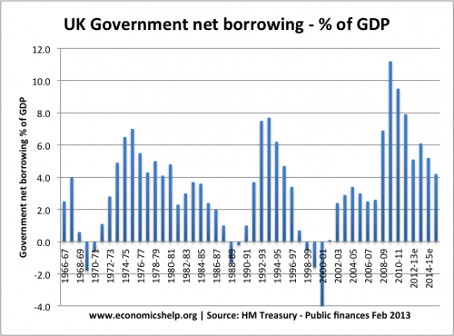
Government Deficit
How has the level of PSNCR changed over the last ten years?
Credit crunch and resulting recession
In tough economic times, government spending exceeds income (More paid in benefits and lower taxes received). This is known as a ‘Fiscal Deficit’ (usually expressed as a % of GDP)
In a buoyant economy, government spending is normally less than income raised through taxation (higher levels of employment and productivity)

Slide 8
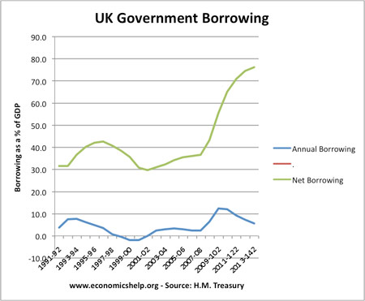
Government Debt
Quoted as Public Sector Net Debt
How is it calculated?
Add up all of the Government
Deficits and Surpluses over time
What does Public Sector Net Debt actually tell us?
The total amount the government actually owes
How has the level of Public Sector Net Debt changed over the last ten years?
A succession of fiscal deficits since 2003 have pushed up accumulated debt to its highest level since the 1960s (when the UK was still paying off the cost of World War II)
Public Sector Net Debt as a proportion of GDP was forecast to peak at 78.0% in 2014-15

Slide 9
Level of unemployment
A key economic indicator is the rise or fall in the number of people seeking work but are unable to do so.
There will always be some unemployment in an economy:
Structural - where industries are in structural decline through lack of competitiveness.
Mining is a good example of this, huge job losses occurred in the late 80’s.
Frictional – caused by time lag between one job and the next.
Seasonal – found in sectors such as agriculture and tourism.
Cyclical – due to downturn in the business cycle

Slide 10
Level of unemployment
High levels of unemployment often mirror particular phases of the business cycle:
A long period of falling and then low unemployment from 1992 (Recession peak) until 2008
Steep increase in unemployment following Credit Crunch and global recession but not as bad as many feared
As economic recovery in the UK has taken hold, unemployment has fallen. It fell by 132,000 between April and June 2014 to 2.08 million, a rate of 6.4%
High or increasing unemployment has a negative impact on government finances – social security payments increase at the same time as a decrease in the amount of tax collected

