Slide 1
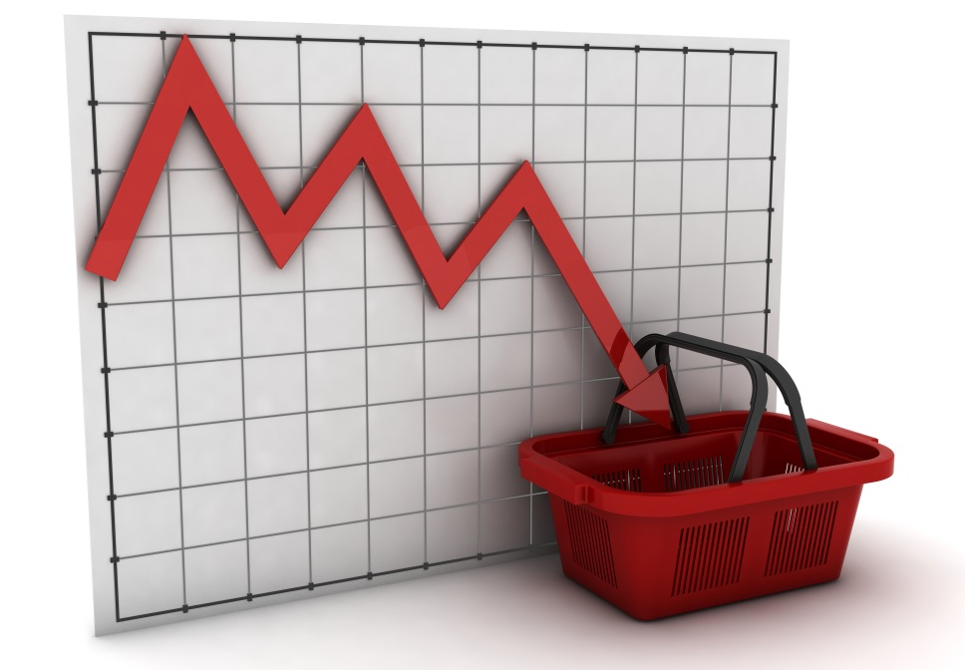
CISI – Financial Products, Markets & Services
Topic – The economic environment
(2.1.4, 2.1.5, 2.1.6) Credit and Inflation

Slide 2
The Credit Creation Process
Most of what is purchased by consumers is not paid for using cash. Buying now and paying later is generally referred to as purchasing goods and services ‘on credit’.
Banks lend most of the deposited funds to borrowers at a higher rate of interest than that paid to depositors
Customers deposit their money into the bank
Bank pays Interest to the depositor for their funds
(At a lower interest rate than that charged to borrowers)
The bank can use some of the surplus to lend again to customers
Borrowers spend this money on goods and services
The bank generates a surplus of money from the difference in the interest charged and received

Slide 3
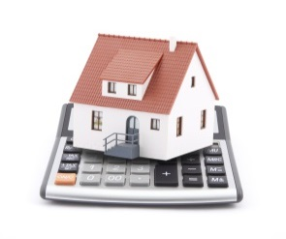
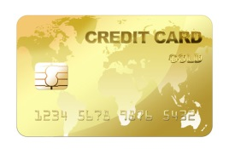
The Credit Creation Process – The Risks
This process accounts for around 96% of the money in circulation in most industrialised nations.
Only 4% is in the form of notes and coins created by the government.
MORTGAGES
PRICES INCREASE
(INFLATION)
OVERDRAFTS
IF THE CREDIT CREATION PROCESS IS UNCONTROLLED
Borrowers
Borrowers spend this money on goods and services
TOO MUCH MONEY CHASING TOO FEW GOODS
LOANS
CREDIT CARDS
The MPC at the Bank of England control interest rates to influence borrowing
HIRE PURCHASE

Slide 4
Inflation - Causes
Rising wages – firms must cover the cost
Excess demand in the economy
(Demand Pull)
Increase in the cost of raw materials
2%
Target
Scarcity of resources – goods or services are in short supply
INFLATION
Increased government taxation
Rapidly increasing government spending
Falling interest rates
Devaluation of a currency – imports become more expensive

Slide 5
Inflation – The Impact
Decreased spending power if salaries are fixed
Value of salary eroded
Employees/
Individuals
Value of savings and future pensions may be difficult to assess
House prices can rise – increases the value of an asset
Businesses must continually update prices to keep pace
Businesses
Profits may suffer if prices are not increased
The value of debt (loans etc.) falls in real terms
The value of national debt is eroded in real terms

Slide 6
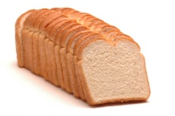
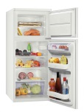
Inflation – Measuring inflation
Included in the basket:
Staples – Milk and Bread
Big ticket items – Cars and Fridges
Regular costs – Petrol and Energy
Fun – Beer and Holidays
On a monthly basis, the ONS collects:
180,000 Prices for 700 goods and services from 20,000 shops in 141 UK locations
Prices also collected by internet and phone.
Prices are weighted according to their importance to form an Index
Works out how much prices have gone UP or DOWN
On an annual basis, the ONS:
Reviews the content of the basket

Slide 7
Inflation – Measuring inflation
There are various measures of inflation. Some of the main measures are:
Retail Price Index
(RPI)
‘Headline’ rate of inflation
Measures general household spending
Includes mortgage and rent payments, food, transport and entertainment
‘Underlying’ rate of inflation
Like RPI except it excludes mortgage interest payments
Removes impact of interest rate changes in general from the measure of inflation
RPIX
Consumer Price Index
(CPI)
Prepared in a standard way across the EU
Does not include mortgage interest payments (Most on the continent rent)
It also excludes other housing costs i.e. ‘depreciation component.
Originally known as the Harmonised Index of Consumer Prices (HICP)
Used by UK government to measure inflation comparatively with other European countries.

Slide 8
Deflation
Deflation is defined as a general fall in price levels.
Demand-side causes:
Negative Demand Shocks e.g. recent falls in oil and commodity prices
Excess capacity and production
Supply-side causes:
Improved productivity
Technological advances
Fall in wages
High exchange rates – fall in import prices
Consequences for an economy:
Consumers may delay spending decisions (Think prices will fall further)
The real value of debt increases – consumers may reduce spending
Reduced profits for businesses – they may look to reduce costs, increasing unemployment
Wages can fall – falls in levels of GDP
It can also encourage consumer spending
New business opportunities can emerge e.g. discount retailers

