Slide 1
CISI – Financial Products, Markets & Services
Topic – Other Retail Financial Products
(10.1) Loans

Slide 2
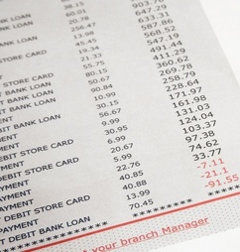
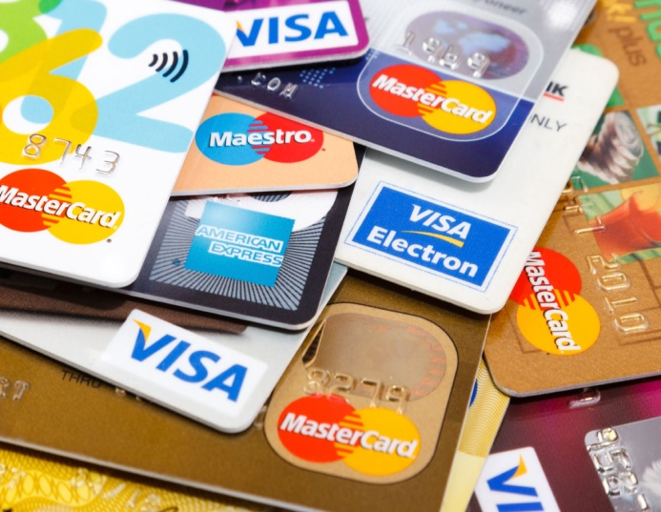
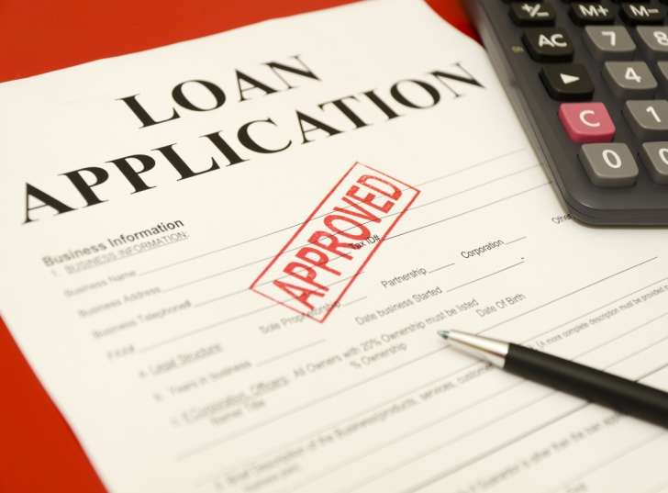
Borrowing Money
The traditional banking model involves financial institutions taking deposits from customers before using a proportion of that money to lend to other customers.
Individuals can borrow money from financial institutions in one of three ways:
Overdrafts
Credit Cards
LOANS
Each type of borrowing is suitable for different purposes. If you get it wrong, you could pay out a lot more than you should have.

Slide 3
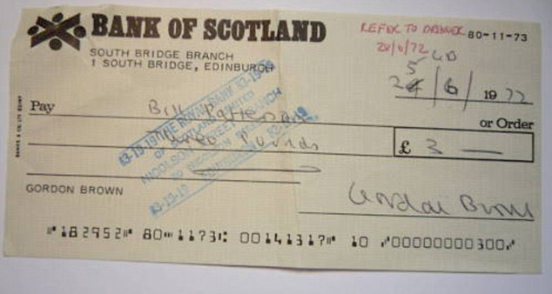
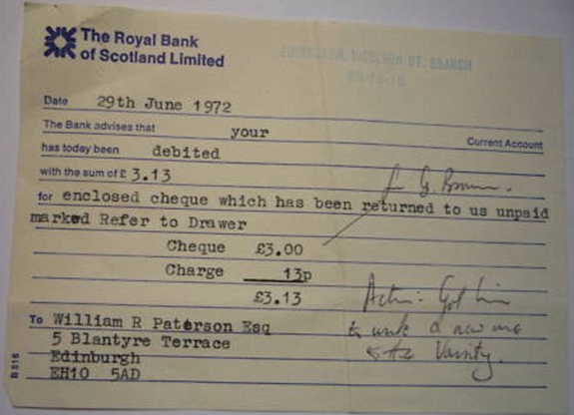
Overdrafts
In 1972, Gordon Brown tried to pay for his university lodgings with a cheque for £3
“Refer to Drawer” is bank-speak for “this person has insufficient funds in his account to pay the cheque”

Slide 4
Overdrafts
Unlike in 1972, today it would be unusual for a bank to bounce a cheque for a relatively small sum.
The bank is more likely to honour the cheque while charging the account holder a fee and a high rate of interest for going ‘overdrawn’.
There are two types of overdraft:
Authorised
Unauthorised
An overdraft limit is agreed in advance with the bank:
Charge interest at a lower rate
Some banks will not charge any interest if a person is overdrawn by a small amount
An overdraft limit has not been agreed in advance with the bank or the agreed limit has been exceeded:
Charge interest at a higher rate
Often charged a fee

Slide 5
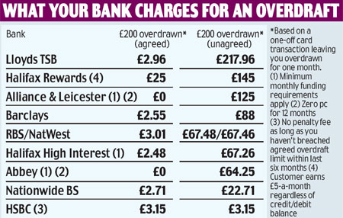
Authorised and Unauthorised Overdrafts
Source: www.thisismoney.co.uk ,2011
If not paid off promptly, unauthorised overdraft fees can accumulate and push up the overdraft to many times the original sum owed to the bank.

Slide 6
Loans
Hot Dog Express Ltd is worried that its bank might withdraw the overdraft facility without any warning. It does not want to suffer the same problems as Rhino Rugby.
Hot Dog Express decides to take out a loan at 13% for £10,000 for a fixed, three-year period. What are the advantages and disadvantages of using a loan instead of an overdraft?
Pros:
As long as Hot Dog Express complies with the conditions of the loan agreement, the bank cannot demand repayment of the loan before the term expires.
The interest rate is only 13.0% - much cheaper than the overdraft rate of 19.3%
Cons:
Hot Dog Express has to borrow the full amount of the loan, which is more than it needs for most of the time
It pays interest on the full amount of the loan
It may have to offer security to prove it can repay the loan

Slide 7
Loans
Loans can be subdivided into two groups:
Unsecured
Secured
Loan is not linked to the item that is purchased with the loan
Typically used to purchase consumer goods
Student loans are also unsecured and are repaid after university.
The lender will check the creditworthiness of
the borrower:
Assess whether he or she can afford to repay the loan and interest over the agreed term from their income given their existing outgoings. (Credit history checks)
It can be difficult for the lender to enforce the loan agreement if the borrower fails to pay – legal proceedings have to be started
The bank gets the right to seize the borrower’s asset if the borrower defaults on the terms of the loan:
The borrower fails to make several interest payments
The borrower fails to make repayments of the principle (original sum borrowed)
Mortgages are examples of secured loans.
The bank is less likely to lose its money:
The risk of default is lower
The lower the risk, the lower the interest rate the bank is likely to charge

Slide 8
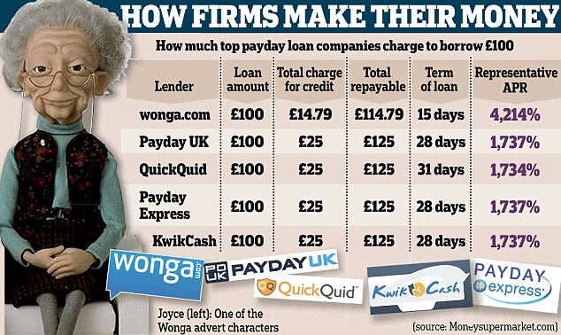
Payday Loans
Payday Lending is when small cash loans are made to individuals. Initially, they were meant to be paid back by an individual the next time they were paid, or at the end of the month.
The term ‘payday loans’ is now used to describe a range of different products but they have some common features:
Short-term unsecured loans for periods up to 12 months although most are for periods of 31 days or less;
they are for relatively small amounts
new borrowers can typically borrow between £100 and £500
Repeat borrowers may be able to borrow more but rarely more than £1,000
New rules on payday loans:
Price cap on the rate of interest – Capped at 0.8% per day
If borrowers do not repay their loans on time, default charges must not exceed £15 and the maximum cost is capped at 100% of the original sum

Slide 9
Bad Credit History?
There are plenty of firms willing to lend money to people with bad credit ratings…at a price
Credit cards are much more widely used in the UK than in other European countries. Most people cannot live without them. Unfortunately, a lot of businesses use them too.

Slide 10
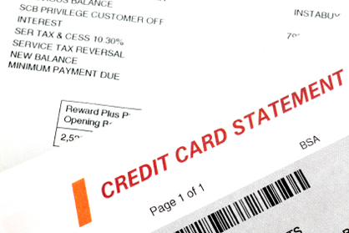
Using Credit Cards
A wide variety of retail goods such as food, electrical goods, petrol and cinema tickets can be paid for using a credit card.
How they work...
The retailer is paid by the credit card company for the goods sold
The credit card company charges the retailer a small fee, but this enables the store to sell goods to customers using their credit cards.
Customers are typically sent a monthly statement by the credit card company.
Customers can choose to pay all the money owed to the credit card company, or just a percentage of the total sum owed.

Slide 11
Paying interest on Credit Cards
Interest is charged on the balance owed by the customer.
The interest rate charged on credit cards is relatively high compared to other forms of borrowing
If a customer pays the full balance each month, he is borrowing interest-free.
It is also common for credit card companies to offer 0% interest to new customers for balances transferred from other cards and for new purchases for a set period, often six months.
The bait...
Credit card interest is so profitable to banks that they entice people to switch their outstanding balance over to a new card.
The bait is 0% interest charged on transferred balances for an extended period. The catch is there’s a fee that has to be paid on the balance transferred – in this case 2.98%.

Slide 12
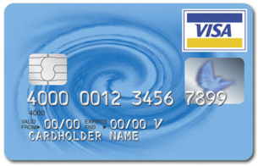
Interest Rates
The costs of borrowing (mainly interest) vary depending on the form of borrowing, how long the money is required for, the security offered and the amount borrowed.
AUTHORISED OVERDRAFT
CREDIT
CARDS
UNAUTHORISED OVERDRAFT
MORTGAGE
Least expensive
Most
expensive

Slide 13
Confusing Interest Rates
EAR – Effective Annual Rate
the annual rate of interest assuming the addition of interest charges to the principal sum (i.e. outstanding balance)
APR – Annual Percentage Rate
the Effective Annual Rate of interest you must pay, and
certain fees associated with the loan.
Under UK law, all lenders have to tell you what their APR is before you sign. The APR doesn’t include all the costs associated with a credit agreement – such as:
charges for late or missed payments
balance transfer fees on a credit card
charges for optional payment protection insurance

Slide 14
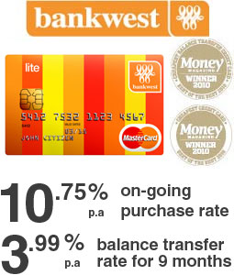
Confusing Interest Rates
It is important to understand what sort of interest rate is being quoted by a lender
A credit card company might advertise an annual rate of 3.99% on the balance you transfer to them:
Interest is charged monthly
3.99% divided by 12 months = 0.3325% per month on outstanding balance
This interest is added to the balance, making it bigger each month
Interest is then charged the next month on the larger balance
To find out what the true interest rate is, use the following formula:
Take 0.3325% and express this as 1.003325
Then multiply to the power of 12 months: 1.003325¹² = 1.04064
1.04064 re-expressed as a percentage is 4.06%
Effective Annual Rate (EAR) is 4.06%

