Slide 1
CISI – Financial Products, Markets & Services
Topic – The Financial Services Industry/Financial Assets and Markets
(1.1.1 and 3.1) Retail Banks, Building Societies and Cash Deposits

Slide 2
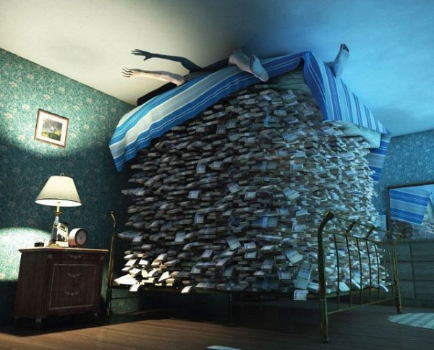
Cash – where to keep it
If you inherited £100,000, if you didn’t spend it, where would you keep it?
Would you simply store your money away at home?
Advantages of doing this?
Easy to access if you need it
Disadvantages of doing this?
Easily stolen
Lose it or misplace it
Easily and possibly aimlessly spent
The money will not work for you!
A more appropriate and safer place to keep it?
In a savings institution

Slide 3
Savings institutions
Savings institutions
Offer personal and small business products and services
Retail
banks
Building
societies
Very large institutions
Often companies with shareholders
grown through linking up with other banks and non-bank institutions such as insurance companies
Jointly owned by the individuals that have deposited or borrowed money (AKA Mutual Societies)
Many have been taken over by banks (demutualisation).
Products and services
Current accounts
Overdrafts
Savings accounts
ISAs
Credit Cards
Loans
Mortgages
Mobile banking
Insurance
Internet banking
Telephone banking
Traveller’s cheques
Currency exchange
Share trading

Slide 4
Bank Interest
Banks and building societies don’t just sit on the money deposited with them. They use it to generate more money:
Banks lend most of the deposited funds to borrowers at a higher rate of interest than that paid to depositors
Customers deposit their money into the bank
Bank pays Interest to the depositor for their funds
The bank generates a surplus of money from the difference in the interest charged and received
The surplus should be enough for the bank to pay it’s operating costs and to generate profits for shareholders

Slide 5
Characteristics of cash deposits
Cash deposits are accounts held with banks or other savings institutions and held by a variety of depositors.
The main characteristics:
The Capital
amount initially invested
repaid in full at the end of a
set period or when withdrawn
The Return
income from interest
Types of deposit accounts:
Instant access
Cash can be withdrawn at any time
Or
Fixed Term
Cash must be kept in the account for a prescribed period of time (normally a year or more)
Or
Notice accounts
The customer must give a certain period of notice before withdrawing money

Slide 6
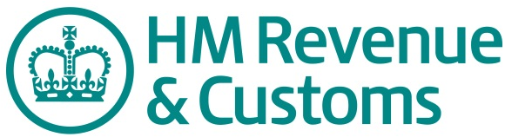
Tax on bank interest
Any interest received by an individual on their savings is subject to income tax.
gross interest
The headline rate of interest quoted by
deposit takers before tax is deducted
net interest
The interest amount paid to customers once tax has been deducted from the gross interest
TAX
Since April 2016, interest is paid gross (without tax deducted deducted) to investors

Slide 7
Tax on bank interest
There has been a new personal savings allowance to remove tax on savings interest:
On up to £1,000 of savings income for basic rate taxpayers
On up to £500 for higher rate taxpayers.
Banks and building societies have been required to stop automatically
taking 20% in income tax from the interest earned on non-ISA savings.
The changes also removed the need for non-taxpayers to complete an R85 form.
Savers are charged a certain percentage of tax on savings interest, depending on their level of income:
Income Tax rates and taxable bands 2016/17
Rate | Income 2016/17
Basic rate (20% tax) | £0 - £32,000
Higher rate (40% tax) | £32,001 - £150,000
Additional rate (45% tax) | Over £150,001

Slide 8
Cash deposits – benefits and risks
Benefits
Risks
Interest earned
Collapse of the institution e.g. Northern Rock
Protected by compensation schemes (if an institution collapses)
Financial Services Compensation Scheme (FSCS) – protects first £75,000 of deposits
Inflation – as prices increase and the value of money is eroded, the returns from interest after tax could be negative.
Interest rate changes – Returns from cash deposits will vary.
Liquidity – easy to get hold of and quick to access when needed.
Exchange rate movements – If money is deposited in a different currency, there is a risk that it will be worth less if the exchange rate changes.

