Slide 1



Fundamentals of Financial Services
Ethics & Integrity in Financial Services

Slide 2
Ethics & Integrity in Financial Services
Everyone MUST
  Be able to list and explain the key principles of ethical behaviour in financial services
Most SHOULD
  Be able to explain the key principles with the use of an example
Stretch & Challenge
  Question: What has been the key consequence of the Libor scandal upon the way ethics is viewed in the financial services sector?
The Development of Ethical Thinking
Ethics in Practice
Ethics in Financial Services
Notes:
1 out of the 30 examination questions will be on this part of the syllabus

Slide 3
Learning Objectives
Everyone MUST
  Be able to list and explain the key principles of ethical behaviour in financial services
Most SHOULD
  Be able to explain the key principles with the use of an example
Stretch & Challenge
  Question: What has been the key consequence of the Libor scandal upon the way ethics is viewed in the financial services sector?
Everyone MUST
  Be able to share their research about a financial scandal from the financial services industry.
Most SHOULD
  Be able to explain the impact of the financial scandals.
Stretch & Challenge
  Choice of two questions:
    Evaluate the key consequences of the recent financial scandals.
    Evaluate the importance of ETHICS in the financial services sector.

Slide 4
Corruption Perceptions Index 2015
Background: Transparency International ( (TI), a body committed to raising anti-corruption standards globally) have conducted this survey measuring public sector corruption across 175 countries.
Consequences of public sector corruption include:
  Poorly equipped schools
  Counterfeit medicine
  Elections decided by money
On a scale from 0 (highly corrupt) to 100 (very clean), not one single country has a perfect score and more than two-thirds score below 50.
A low score is a sign of widespread bribery, lack of punishment for corruption and public institutions that don’t respond to citizens’ needs.
ACTION: The G20 needs to prove its global leadership role and prevent money laundering and stop secret companies from masking corruption.
Notes:
http://www.transparency.org/cpi2015

Slide 5
Corruption Perceptions Index 2015
Notes:
http://www.transparency.org/cpi2015#downloads

Slide 6
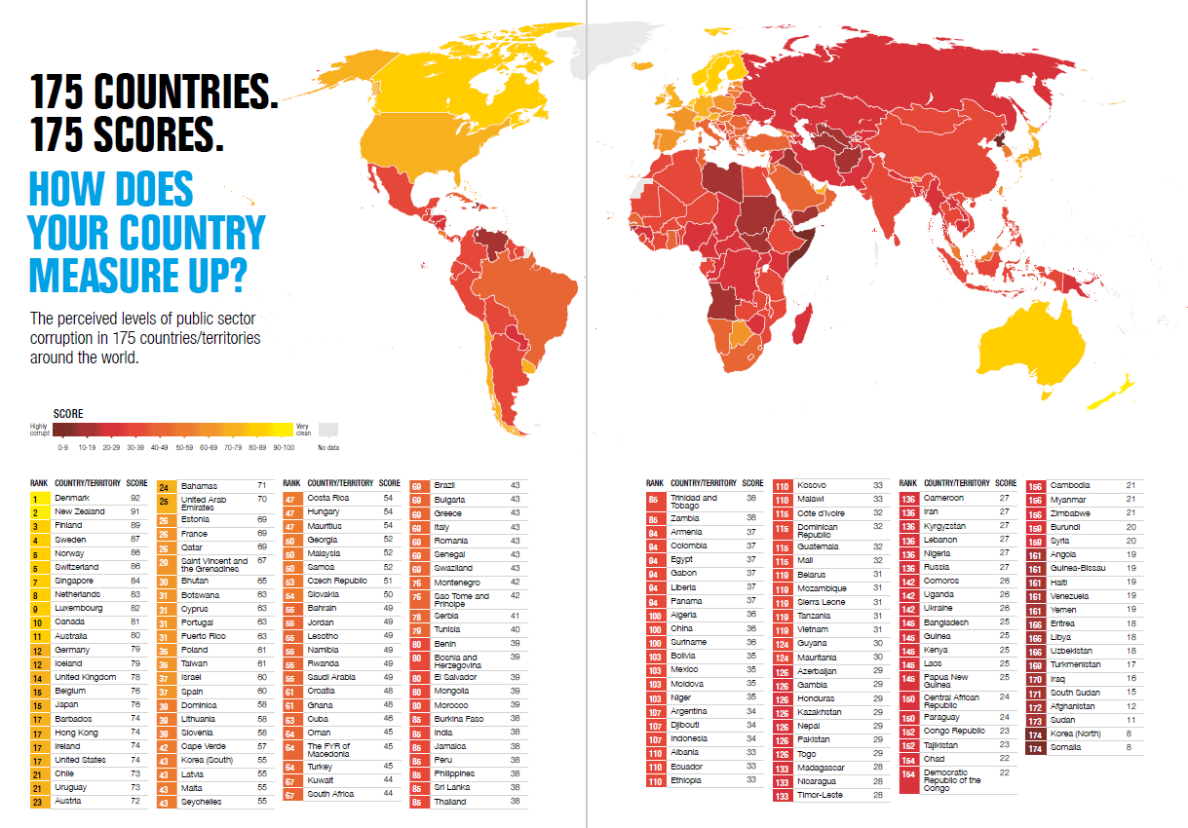
Comparison to: Corruption Perceptions Index 2014
Notes:
Source: http://www.transparency.org/whatwedo/publication/cpi2014

Slide 7
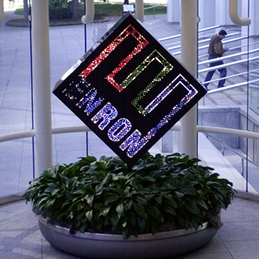
Ethics in Financial Services
The same “rules” regarding ethics apply to the financial services industry.
However, the integrity of people and practices in financial services has been undermined by a number of recent scandals.
Click picture to view trailer for “Enron: The Smartest Guys in the Room”
Notes:
https://www.youtube.com/watch?v=o4WkR3f8Qw4
Trailer to Enron: The Smartest Guys in the Room (movie)

Slide 8
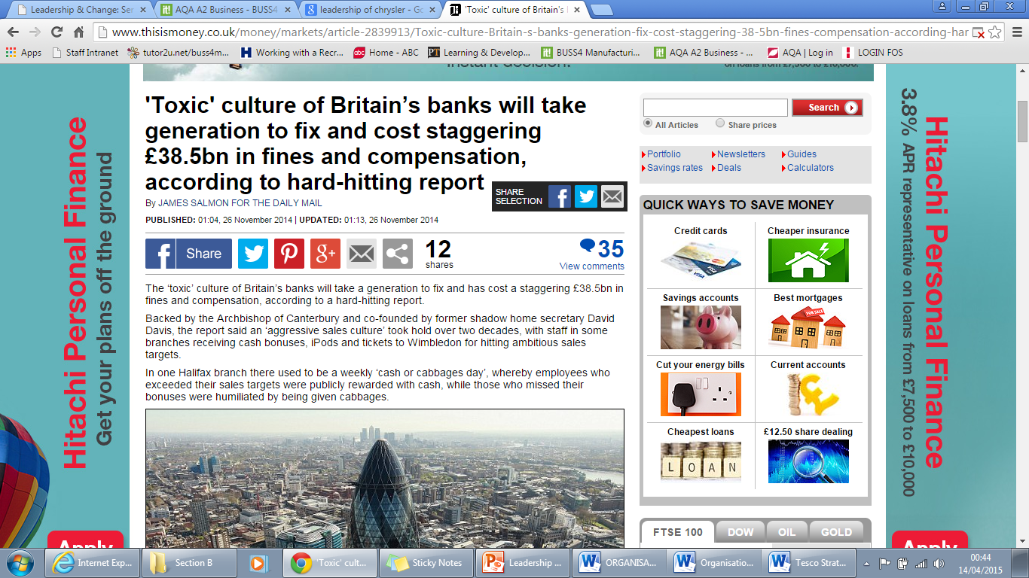
Ethics in Financial Services
Summarise the articles.
What do they tell us about the culture of British banks?
Notes:
Enron

Slide 9


Toxic Culture
When the culture of a business acts as a liability for them
Barclays
Barclays was one of several leading banks that were implicated in a scandal involving the fixing of the Libor interest rate.
Whistle-blowers pointed to a culture of fear that allowed the practice to go on.
The Serious Fraud Office launched a criminal inquiry into interest rate fixing amid increasing clamour for rogue bankers to be prosecuted.
The Libor scandal was a key factor in the appointment of Antony Jenkins as the new CEO of Barclays.
One of his first actions was to commission an independent review into the culture at Barclays – which he clearly feared was turning toxic.
The subsequent Salz Review blamed "cultural shortcomings" at the bank for problems that led to the Libor-rigging scandal. The Salz Review said the bank needed a "transformational change" to restore its reputation among the public. The review said the bank had become too focused on profit and bonuses rather than the interests of customers.
Notes:
http://www.independent.co.uk/news/business/news/exclusive-barclays-insider-lifts-lid-on-banks-toxic-culture-7920809.html
http://www.bbc.co.uk/news/business-22012261

Slide 10
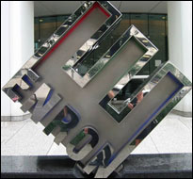
Toxic Culture
Perhaps the best example of how a toxic culture can ultimately lead to the collapse of an organisation.
In Enron's case, this collapse was one of the biggest corporate scandals of all time and much of it can be directly traced to the culture of greed, aggression and plain illegal behaviour that was encouraged and tolerated by the senior management team.
Notes:
http://www.businessweek.com/stories/2003-03-30/an-insiders-tale-of-enrons-toxic-culture
Article.
https://www.youtube.com/watch?v=bOkCK9gC8H8 Video on Culture

Slide 11
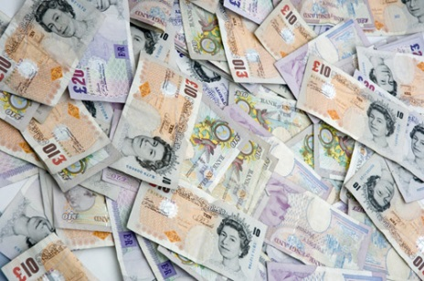
Scenario
You have inherited a sum of money…
You wish to make a financial provision for the future but are unsure about whether to just save the money in your savings account at the bank or to invest in an alternative financial product. You are keen to maximise your return.
You see two advertisements for financial products which seem attractive.
You contact the companies and arrange to meet with the designated sales person.
Your experiences are as follows:

Slide 12

Read the experiences and discuss the questions which follow:
What is positive/negative about each experience?
Which sales person is displaying ethical/unethical behaviour?
What do you think has led them to behave in this way?
Company A: Sales Exec. Peter Smith
Peter explains the product to you in general terms, focusing particularly on the return offered by the product.
Peter tries to explain to you how the company can improve the return to you (which is over and above what your bank can offer on your savings account). You are not financially aware and do not really understand what the salesperson is saying.
You ask some questions for further clarification. Peter uses phrases such as “no-one else asked me about that”, and “don’t worry, I wouldn’t sell a product that I didn’t have confidence in”. Peter also suggests that this is a limited opportunity and you need to decide right now if you wish to take advantage of it.
He does not indicate whether or not he would be financially rewarded on selling this product to you.
Company B: Sales Exec. Chris McCarthy
Chris takes you through the structure of the product offered in such a manner that you are reasonably sure that you understand what it is and from whom you are buying.
Chris answers any questions that you have, giving full clarification.
Chris explains the factors which determine the rate of return that is offered, and tells you whether that is an actual rate or an anticipated rate which is dependent upon certain other things happening, over which the product originator may have no control.
Chris also tells you what he will be paid a commission if you buy the product.
Notes:
Students to understand the two types of sales person – ethical vs. unethical

Slide 13
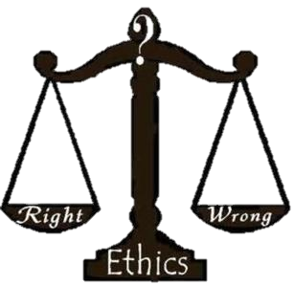
Are they adhering to the key principles of ethical behaviour?
Honesty
Openness
Transparency
Fairness

Slide 14
Stretch & Challenge Questions:
You will be given one of the following questions to discuss and generate ideas for:
  Evaluate the key consequences of the recent financial scandals.
  Evaluate the importance of ETHICS in the financial services sector.
Consider the implications discussed already.
How has this affected the importance of ETHICS in the financial services sector?
Refer to some of the examples you are now aware of as evidence to support your case.
What was the most SIGNIFICANT implication?
Do you think the proposed changes/actions would lead to greater integrity of people and practices in financial services?
Is “behaving ethically” given more importance and are companies making active changes to ensure people and practices are more ethically sound?

Slide 15

Check your learning: EXIT PASS
Do you:
Know the key principles of ethical behaviour in financial services
  Jot them down on your cue card and explain what each one means
  Put your name on your cue card
  Hand it in…on your way out…!

Slide 16
Useful Links/Articles
Article: ‘I Swear I Will Be Ethical’: Why an Oath is Just a Start (09/2015)
  http://business-ethics.com/2015/09/11/1255-i-swear-i-will-be-ethical-why-an-oath-is-just-a-start/
Report: ‘Unethical Behavior’ Continues to Plague Financial Services Industry (05/2015)
  http://business-ethics.com/2015/05/28/0920-survey-unethical-behavior-continues-to-plague-financial-services-industry/

