Slide 1
Fundamentals of Financial Services Development of Ethical Thinking & Ethical Practice
Ethics & Integrity in Financial Services

Slide 2
Ethics & Integrity in Financial Services
Everyone MUST
Be able to list and explain the key principles of ethical behaviour in financial services
Most SHOULD
Be able to explain the key principles with the use of an example
Stretch & Challenge
Question: What has been the key consequence of the Libor scandal upon the way ethics is viewed in the financial services sector?
The Development of Ethical Thinking
Ethics in Practice
Ethics in Financial Services
Notes:
1 out of the 30 examination questions will be on this part of the syllabus

Slide 3
Learning Objectives
Everyone MUST
Be able to list and explain the key principles of ethical behaviour in financial services
Most SHOULD
Be able to explain the key principles with the use of an example
Stretch & Challenge
Question: What has been the key consequence of the Libor scandal upon the way ethics is viewed in the financial services sector?
Everyone MUST
Be able to list and explain the key principles of ethical behaviour in financial services
Most SHOULD
Be able to explain the key principles of ethical behaviour with the use of an example

Slide 4
What is Ethics?
On your post-it note jot down what the term “ethics” means to you and bring it up to the board:
ETHICS

Slide 5
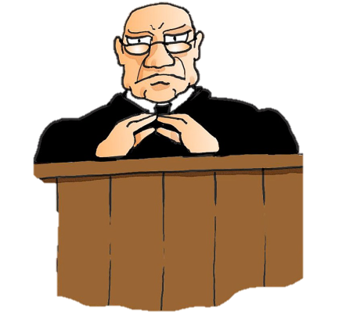
Law vs. Ethics
Are Law and Ethics the same thing?
Notes:
Will someone be punished for behaving unethical?
Is it illegal to act unethically?

Slide 6
Law vs. Ethics
LAW
ETHICS
Law is about what is lawful and what is unlawful
Ethics are about what is right and what is wrong
An ethical decision is one that is both legal and meets the shared ethical standards of the community

Slide 7
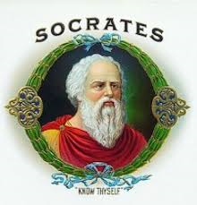
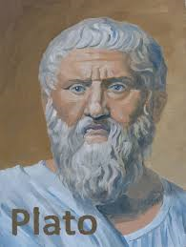
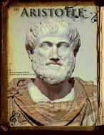
Development of Ethical Thinking
Early ideas were contributed by the Greek Philosophers
The key contributor being Aristotle, who introduced “virtue ethics”. This philosophy requires that individuals actively do good, rather than just being a good person within themselves. He has also been linked to the idea of “natural law” which suggests that there exists an innate law, or coded behaviour, with which everyone is born.

Slide 8
Ethics in Practice
“Doing the right thing”
You make the choice about the actions that you take
Why do you think these individuals/companies behaved unethically despite knowing the potential negative implications of their behaviour?
Why do some companies continue to behave unethically?
Notes:
Give students a list of the top 10 unethical companies in the world by www.actionforourplant.com
Give students the background to some businesses that have had boycotts applied to them http://www.ethical.org.au/get-informed/boycotts-criticisms/boycotts/

Slide 9
Which professions would you generally trust to tell the truth?
*

Slide 10
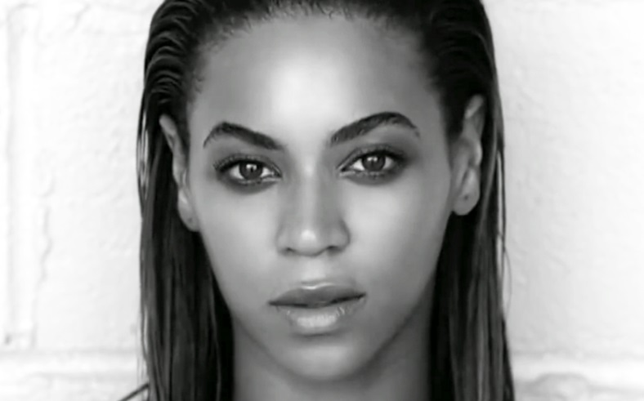
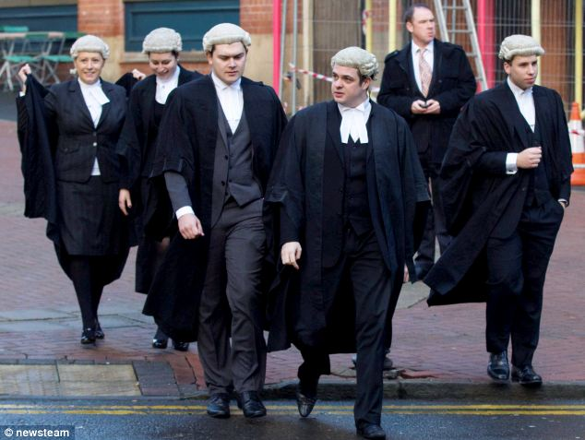
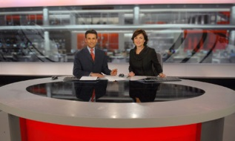
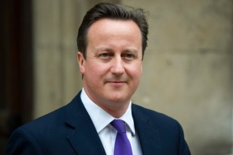
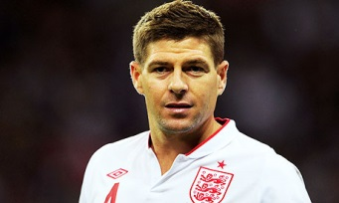
Who do you trust?
*
*
Discuss with your partner…who do you trust?
Notes:
Speak with the person next to you
Who do you trust?
Celebrities?
News readers?
Lawyers?
Politicians?
Sportsmen/women?
Your teacher?
Your doctor?
Friends?
Parents?
Why do you trust them?
What would they have to do to lose your trust?

Slide 11
Survey 2015: The 5 most trusted professions
*
Source: Ipsos MORI Political Monitor, Jan 2015
Notes:
Students to be provided with trust data. They can discuss the data in pairs, groups or as a class.
https://www.ipsos-mori.com/researchpublications/researcharchive/3685/Politicians-are-still-trusted-less-than-estate-agents-journalists-and-bankers.aspx#gallery[m]/1/
https://www.ipsos-mori.com/researchpublications/researcharchive/15/Trust-in-Professions.aspx?view=wide

Slide 12
Survey 2015: Trust in Industry
*
Source: Ipsos MORI Political Monitor, Jan 2015
Notes:
Students to be provided with trust data. They can discuss the data in pairs, groups or as a class.
https://www.ipsos-mori.com/researchpublications/researcharchive/3685/Politicians-are-still-trusted-less-than-estate-agents-journalists-and-bankers.aspx#gallery[m]/1/
https://www.ipsos-mori.com/researchpublications/researcharchive/15/Trust-in-Professions.aspx?view=wide

Slide 13
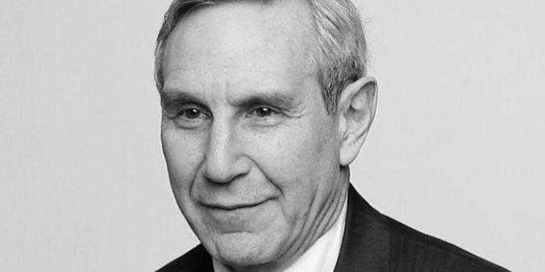
Edelman Trust Barometer 2016
The survey is Edelman’s 16th annual trust and credibility survey. It measures trust across a number of institutions, sectors and geographies.
The 2016 Edelman Trust Barometer surveyed more than 33,000 respondents across 28 countries.
The Edelman Trust Barometer 2016 has revealed A Tale of Two Britains. A yawning gap has opened between Britain’s haves and have-nots in Edelman’s annual survey of how much trust we place in the institutions that dominate our lives. The trust that Britons feel in government, business, the media and NGOs depends on where they stand in the social hierarchy.
Source: Edelman Trust Barometer 2016
Notes:
Richard Edelman is the president and CEO of Edelman, a leading communications marketing firm.
http://www.edelman.co.uk/magazine/posts/trust-barometer-2016/

Slide 14
Edelman Trust Barometer 2016
Highlights
Some of the key findings in the UK reveal:
Little trust in politicians, but business stages a trust revival
Brexit strongly favoured by those struggling through austerity; the wealthy want to stay in the EU
Trust in business reaches a post-crisis high – but only among the well-off
The biggest “trust gap” of all institutions is in relation to business
Paying tax and behaving responsibly remain the major divers of increased trust in business
Source: Edelman Trust Barometer 2016
Notes:
Click on image to watch the 2016 highlights.
Read the Edelman Trust Press Release for Business 2016 – outlining the key implications for businesses – as a case study with the class.
http://www.edelman.co.uk/magazine/posts/trust-barometer-2016/

Slide 15
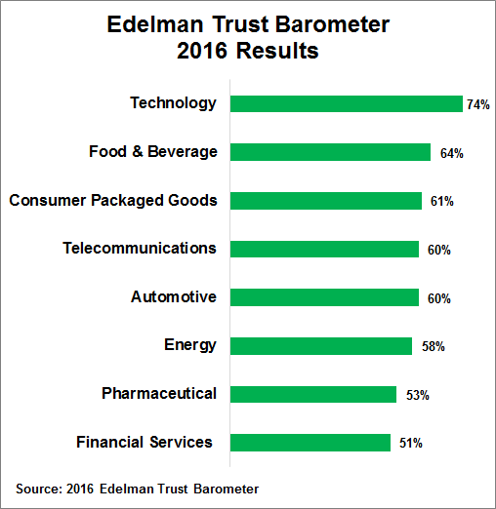
Financial services is the least trusted industry globally…
“Financial services ranked last in the 25-country survey of the general population with a 51% trust rating.
The good news is that public trust in financial services has increased 8% since the 2012 survey”
*
Source: CFA Institute
Notes:
Read: https://blogs.cfainstitute.org/marketintegrity/2016/02/05/edelman-trust-barometer-2016-a-mixed-bag-for-financial-services-sector/

Slide 16
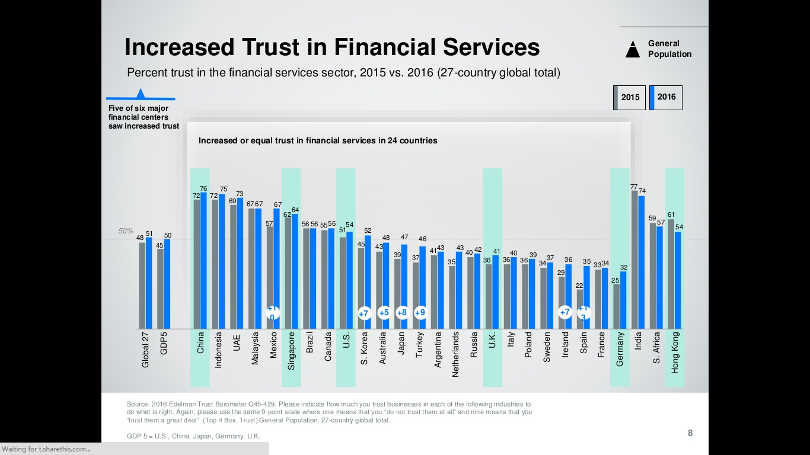
Increased Trust in Financial Services 2016
Source: Edelman Trust in Financial Services 2016
Notes:
http://www.edelman.com/insights/intellectual-property/2016-edelman-trust-barometer/state-of-trust/trust-in-financial-services-trust-rebound/

Slide 17
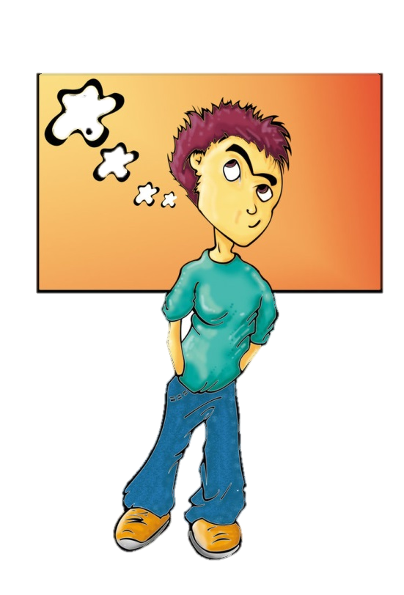
4 Key Principles of Ethical Behaviour
Is what I am about to do, or are the actions that I am about to take:
Open
Honest
Transparent
Fair

Slide 18
SUMMARY
How important is ethics:
In your personal life?
In your professional life?
What are the 4 key principles of ethics that will help you assess whether a decision is ethical or not?

